Slide 1
Azure Community Conference 2021

Slide 2


Title Sponsor
Gold Sponsor
Community Partner

Slide 3

DEEPTHI GOGURI
SQL Server Database Administrator, MCT

Slide 4
Azure Fundamentals 101
Deepthi Goguri

Slide 5
Overview
Azure – Deployment options
Service Tiers, Compute tiers
Creating Azure SQL database
Resources

Slide 6



Azure Deployment options
SQL Server on Azure VM
SQL Managed Instance
Azure SQL DB

Slide 7
Differences
SQL Server on Azure VM
SQL Managed Instance
Azure SQL DB
OS and SQL Server access
Version of your choice
Automated backups and security patches
Supports older versions of SQL Server
Images, Iaas Extension
No OS access
Control Instance capabilities
SQL Agent, Dbmail, linked servers, service broker etc.
SQL Database only
No OS or SQL instance
Access to database scoped features only
Modern cloud applications

Slide 8
Comparison
Feature | Azure SQL Database | Azure SQL Managed Instance
Change data capture (CDC) | NO | YES
Common language runtime (CLR) | NO | YES
Cross-database/three-part name queries | NO | YES
Cross-database transactions | NO | YES
Database mail | NO | YES
Resource Governor | NO | YES
Automatic tuning (indexes) | YES | NO
SQL Server agent | NO | YES
For all Feature differences: https://docs.microsoft.com/en-us/azure/azure-sql/database/features-comparison

Slide 9
Purchasing models
DTU (bundle of compute, storage and I/O)
Basic, standard and premium
vCore (choose compute and storage separately)
General purpose, hyperscale and business critical
Azure hybrid benefit
Reserved capacity
SQL managed instance only option
Source: https://docs.microsoft.com/en-us/azure/azure-sql/database/migrate-dtu-to-vcore

Slide 10
Service tiers
General purpose
- Most business uses
- low budget
- only one Primary
- No secondary standby
- Serverless
- Up to 80 vCores
- Up to 4TB
Business critical
- Read workloads like reporting
- In-Memory OLTP
- Includes readable secondaries
- Low latency
- High cost
- Up to 128 vCores
-Up to 4TB
Hyperscale
- Single Azure SQL databases only
- Storages up to 100TB
- Point in time restores
- 4 readable replicas
- Up to 80 vCores
Source: https://docs.microsoft.com/en-us/azure/azure-sql/database/service-tiers-general-purpose-business-critical

Slide 11
Compute tiers
Provisioned
- Fixed resources
- Be charged regardless of these resource usage
Serverless
- Intermittent and unpredictable workloads
- Automatic compute scaling
- Min and max vCores
- Billed only for the resources used
- Automatic pausing when not used
- Pay only for storage

Slide 12
How to create Azure SQL Database?

Slide 13
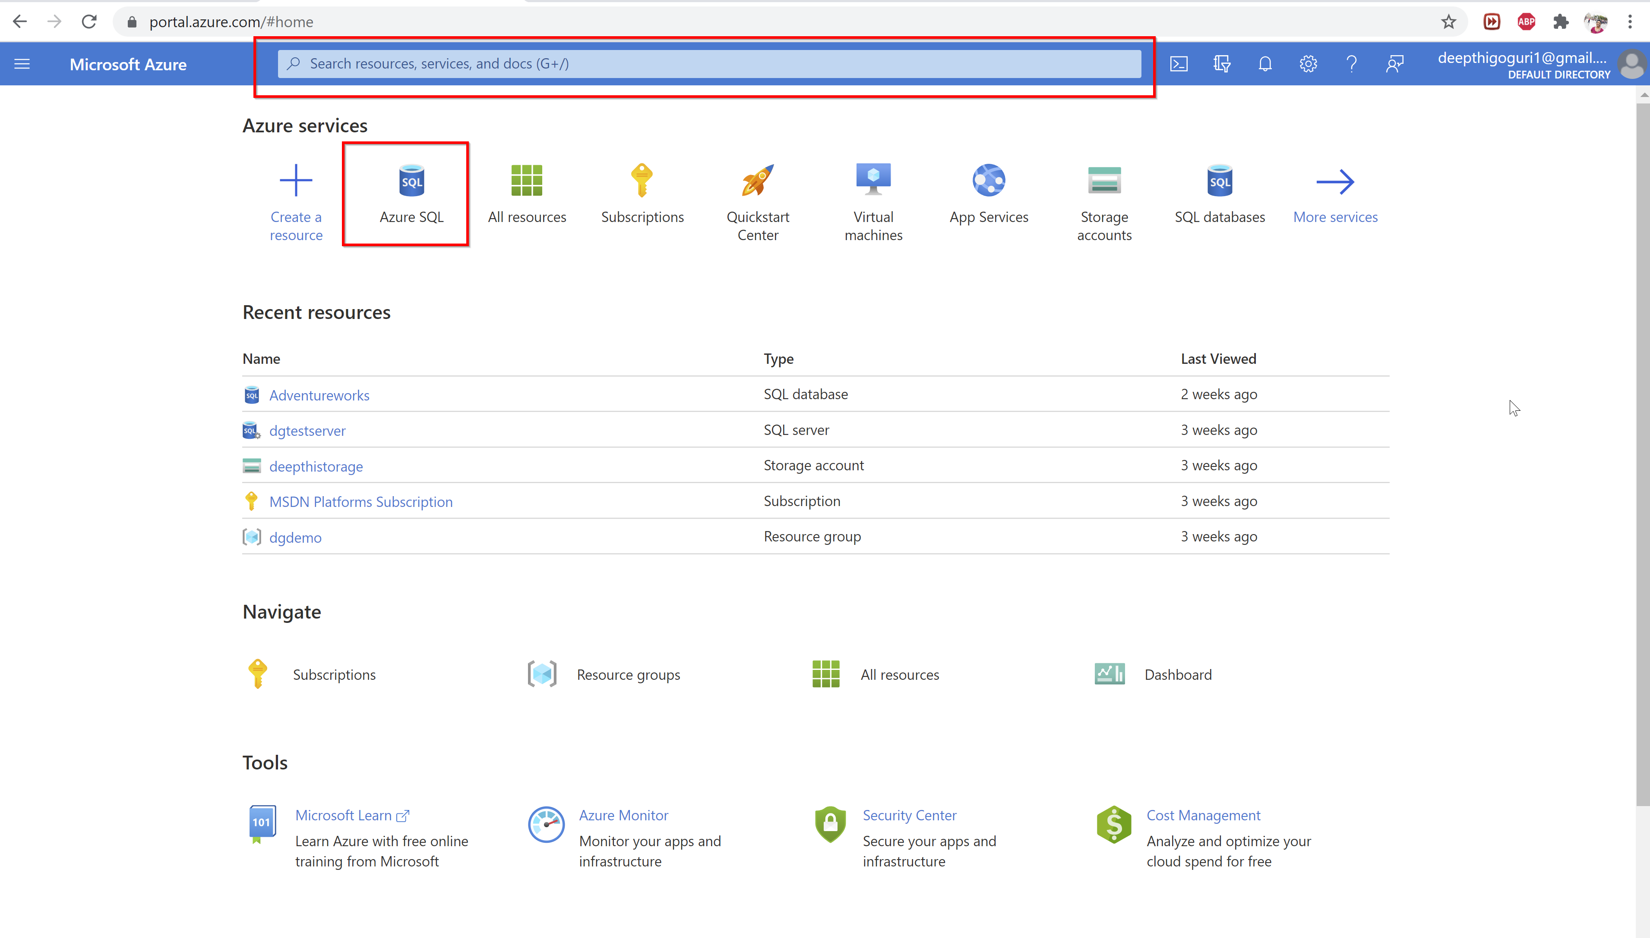

Slide 14
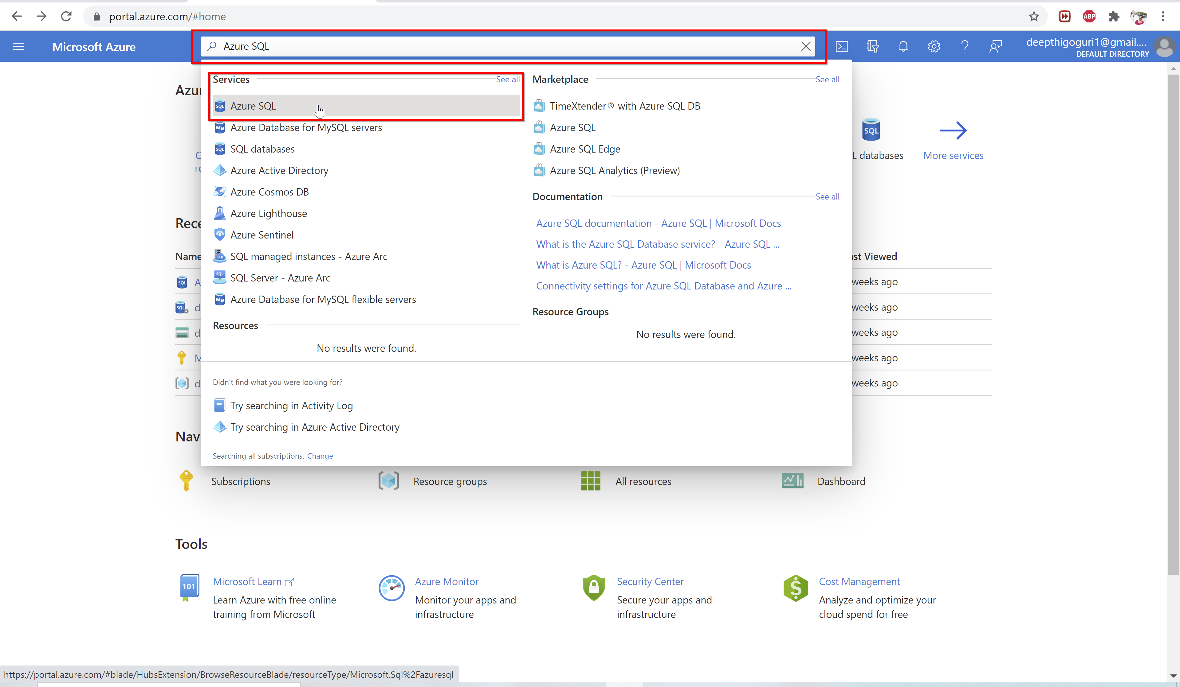

Slide 15
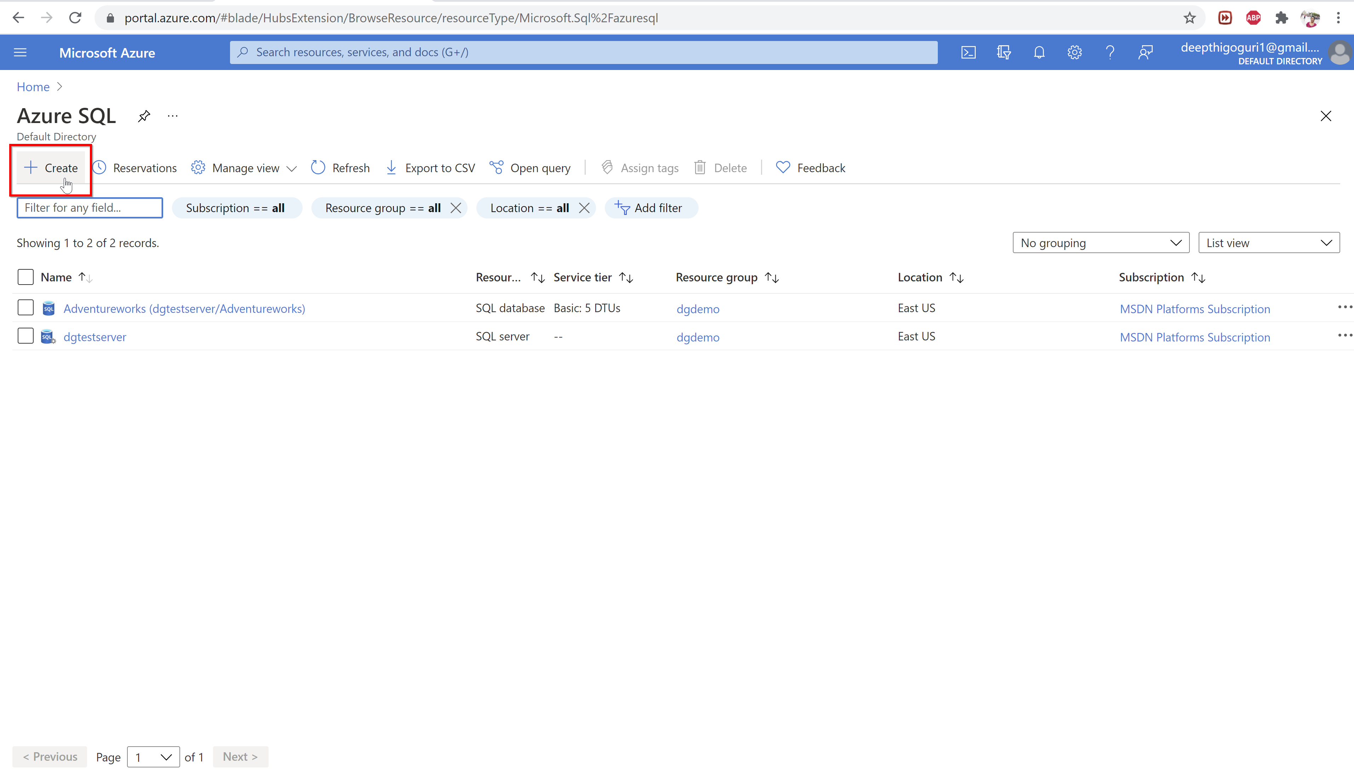

Slide 16
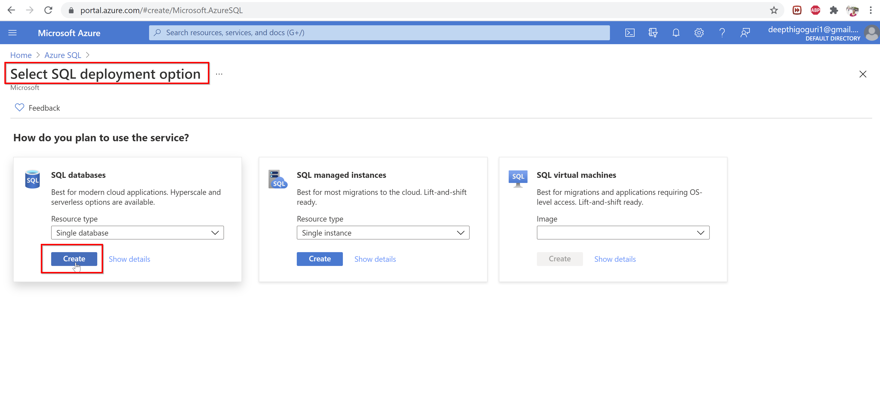

Slide 17
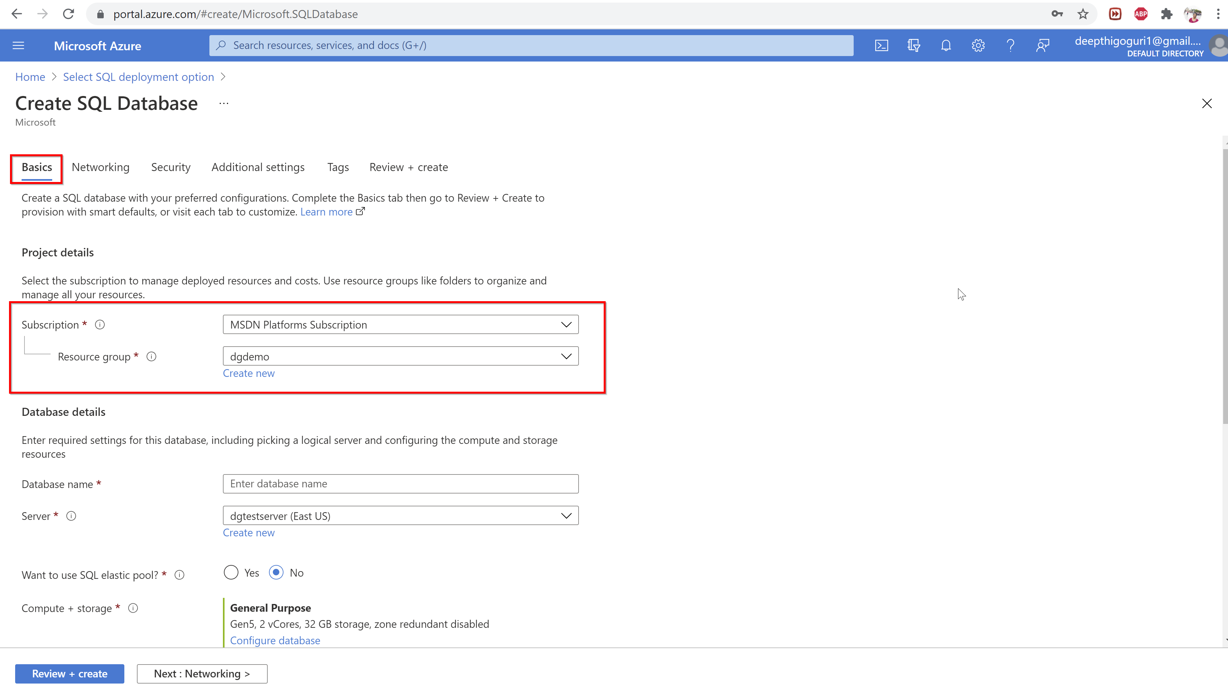

Slide 18
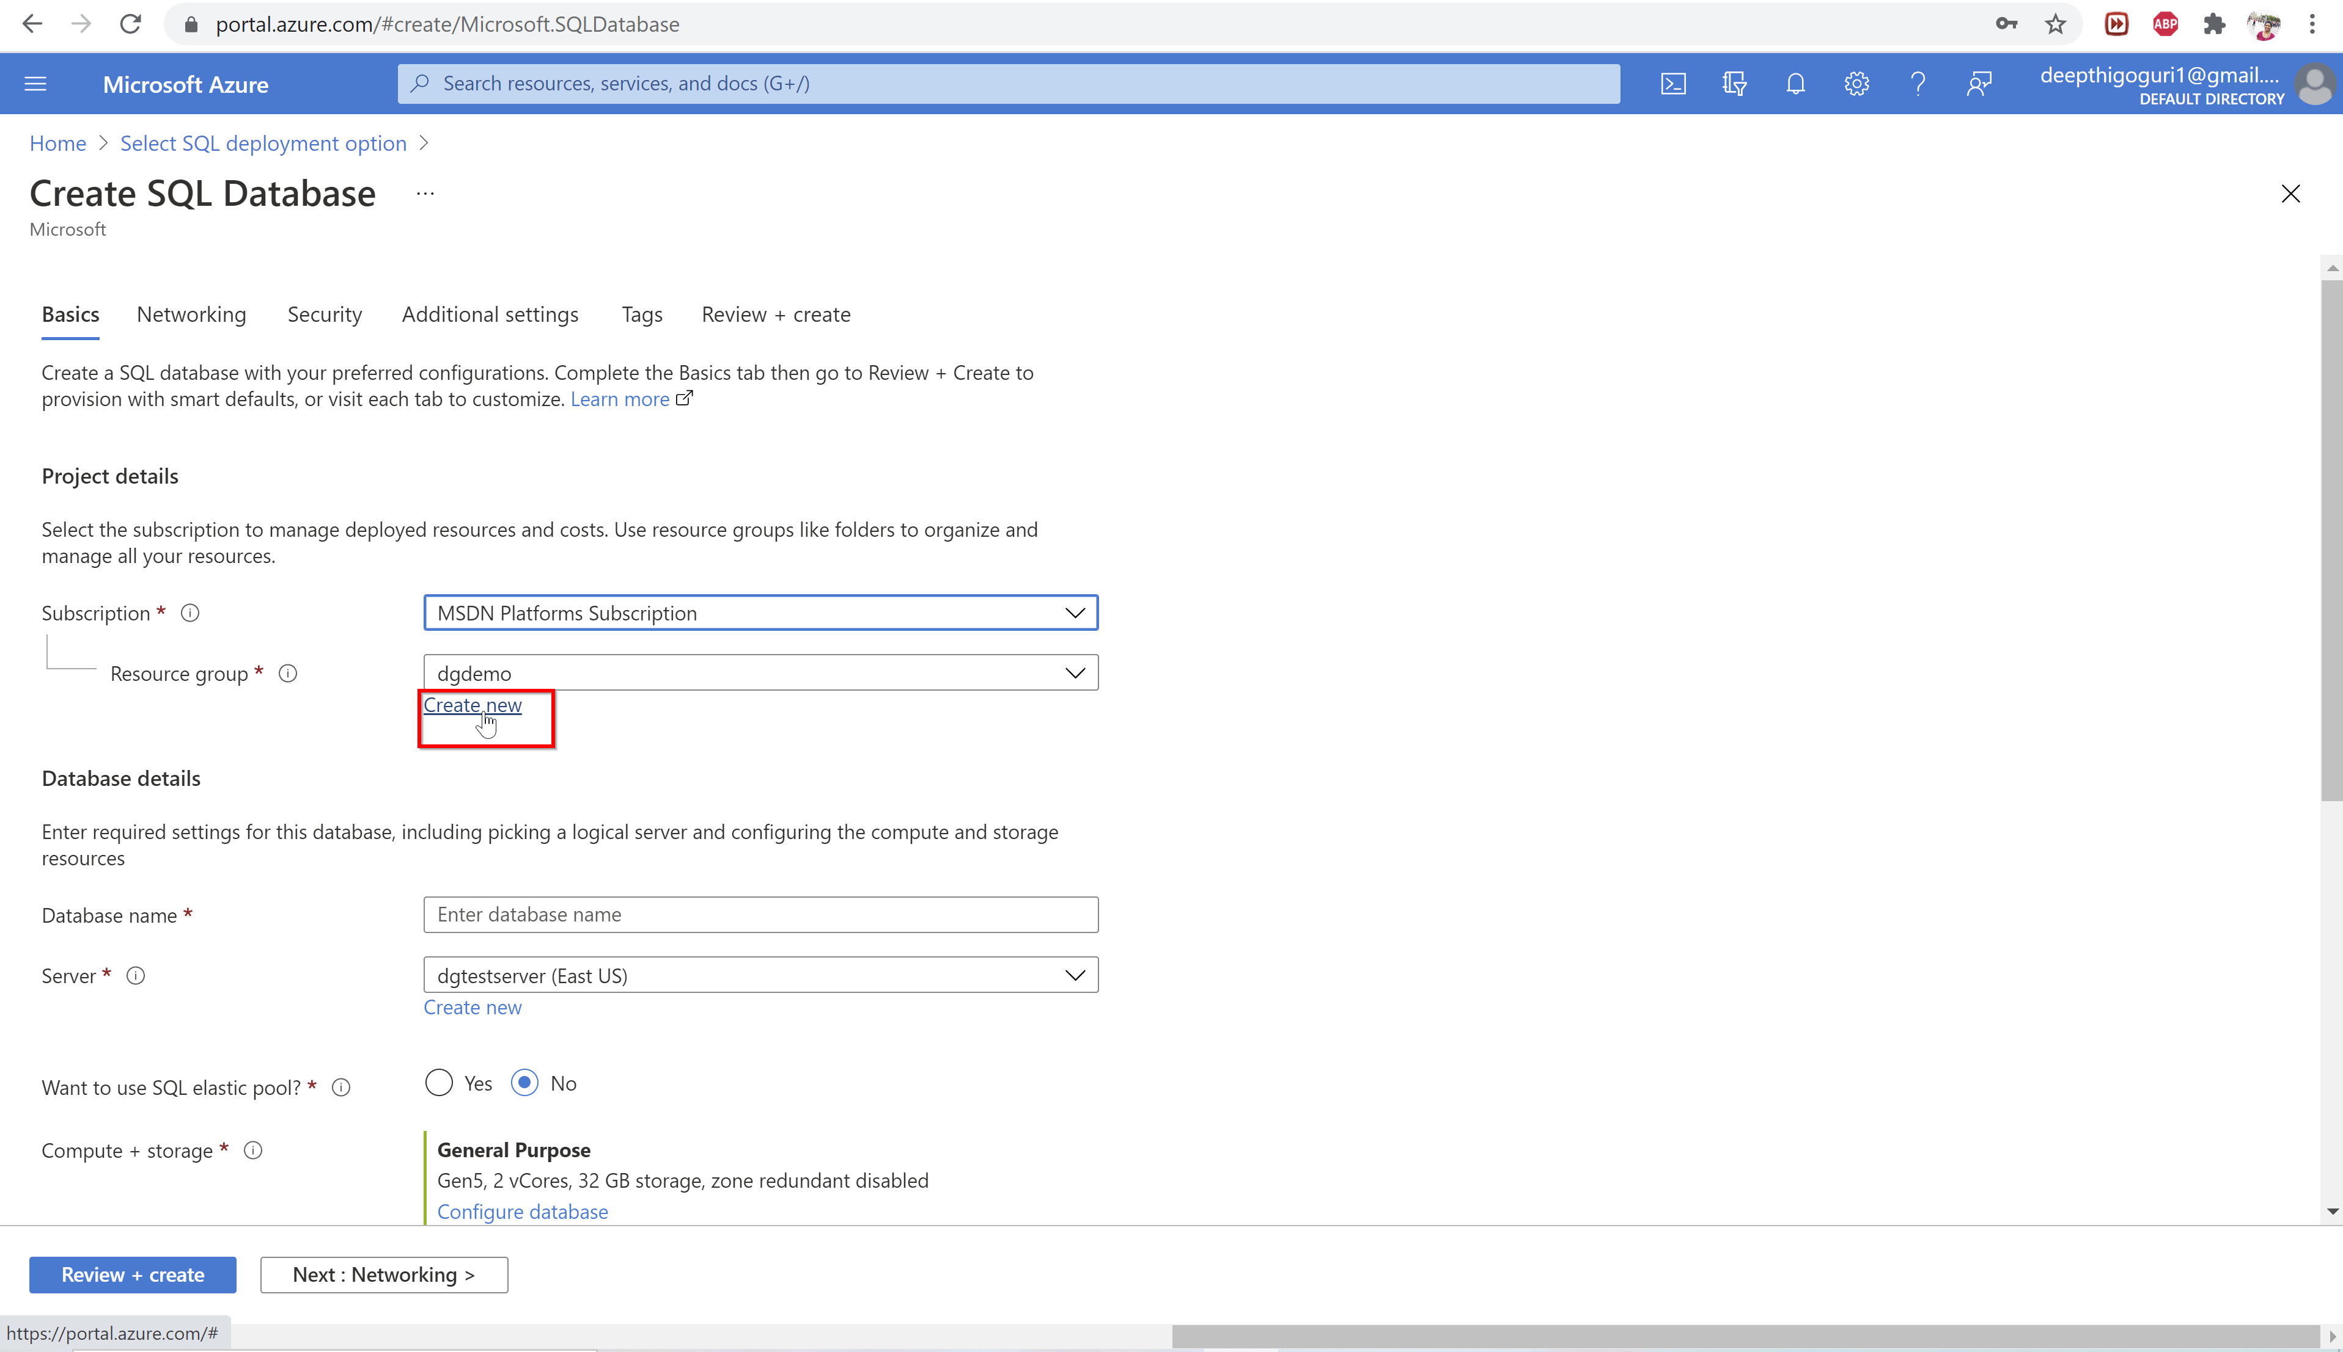

Slide 19
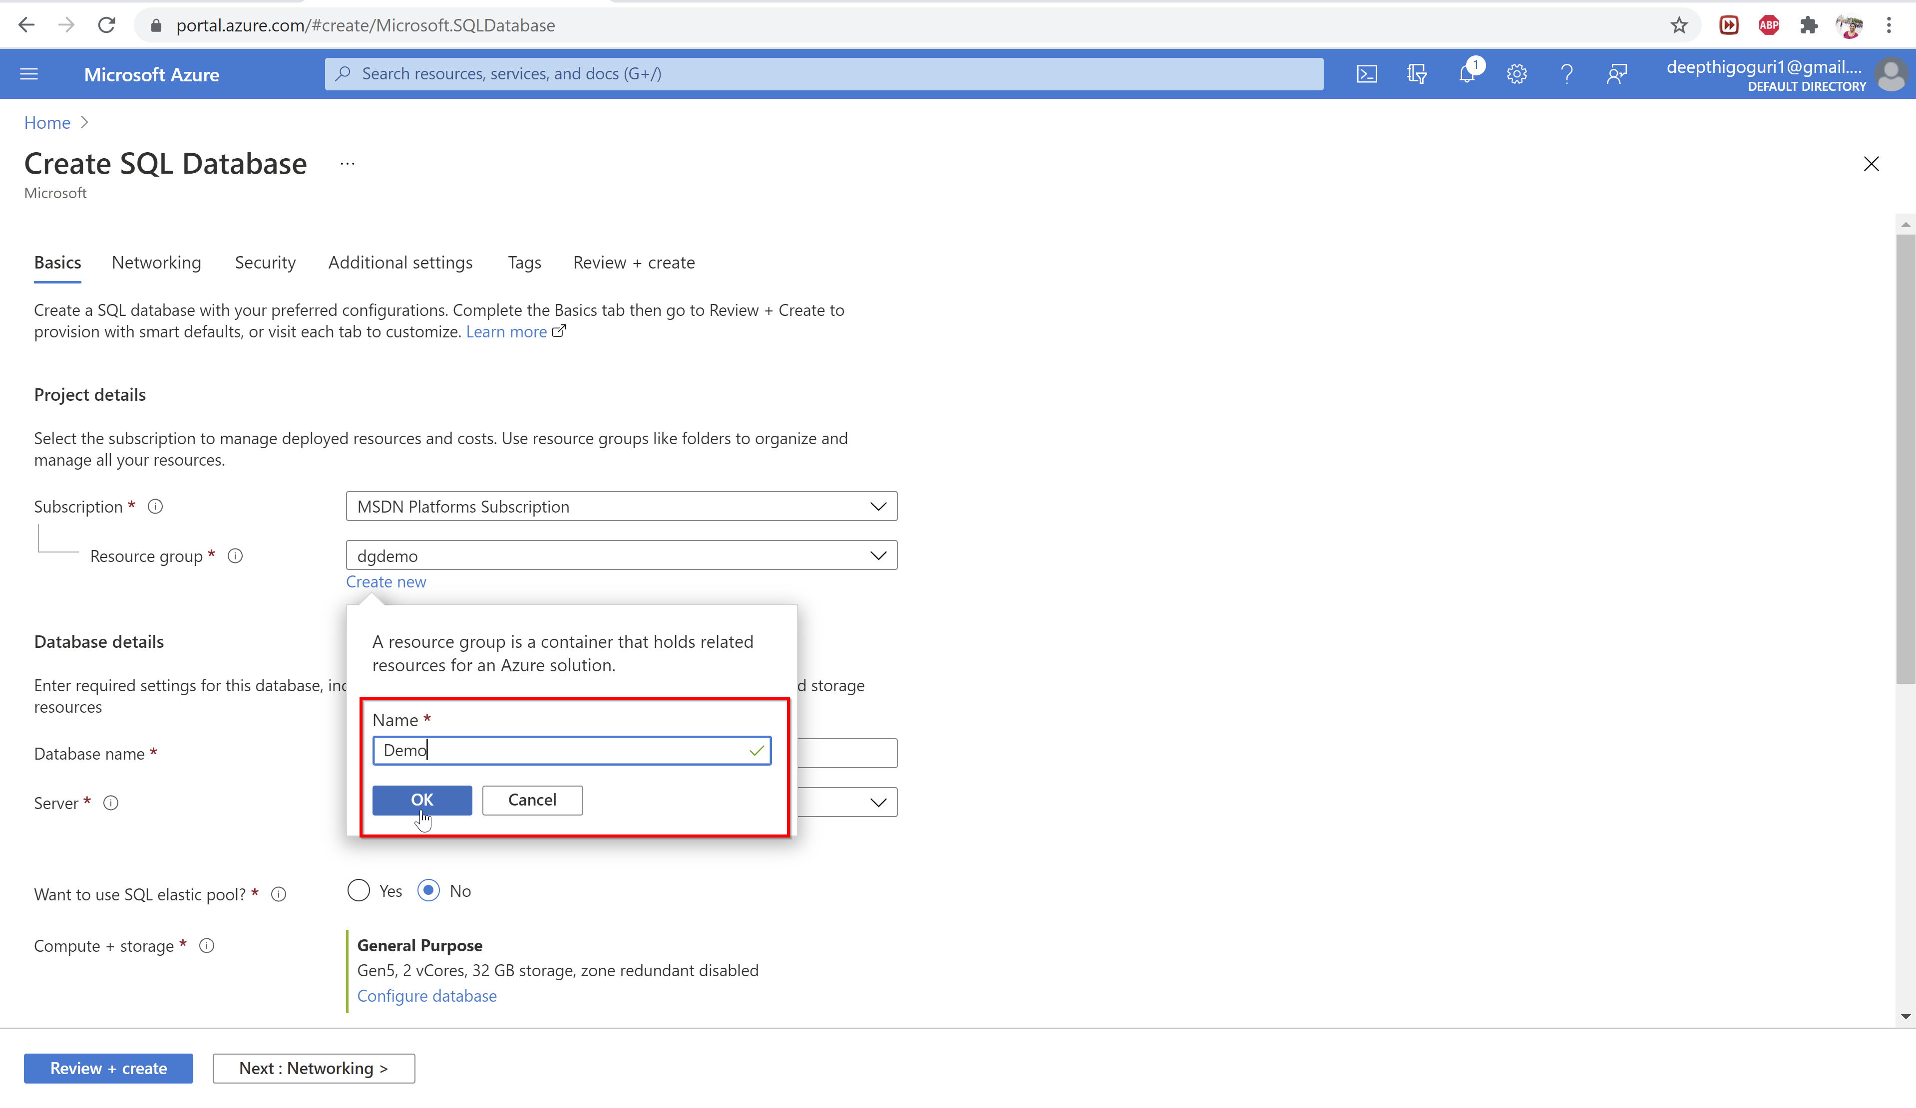

Slide 20
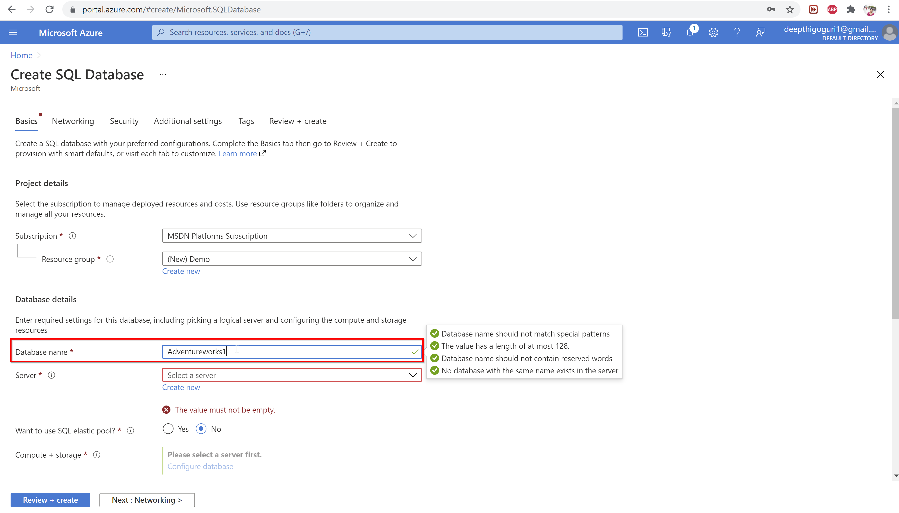

Slide 21
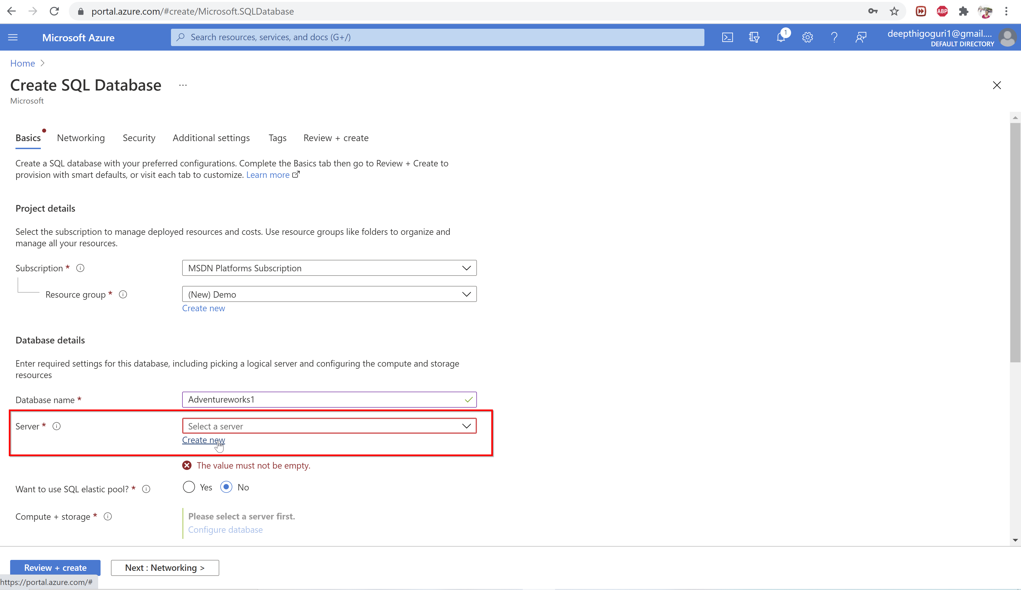

Slide 22
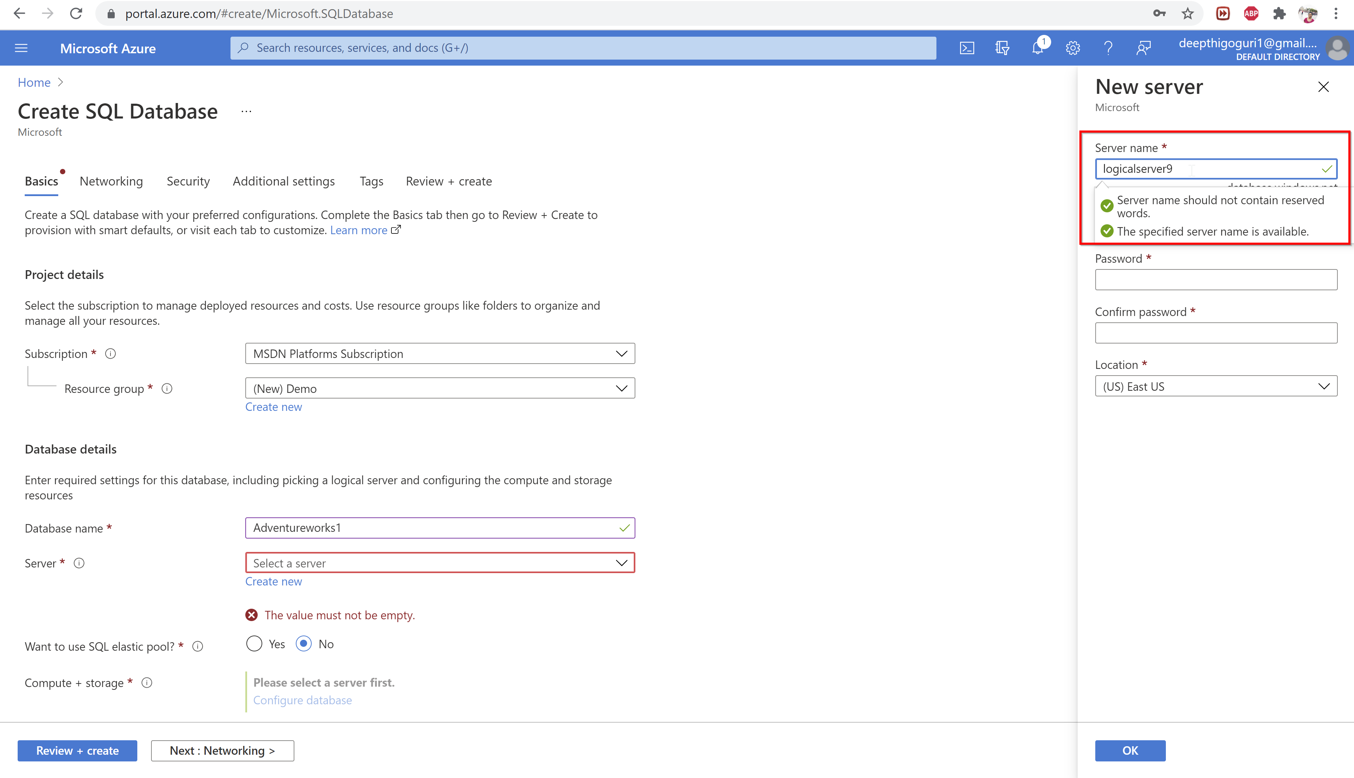

Slide 23
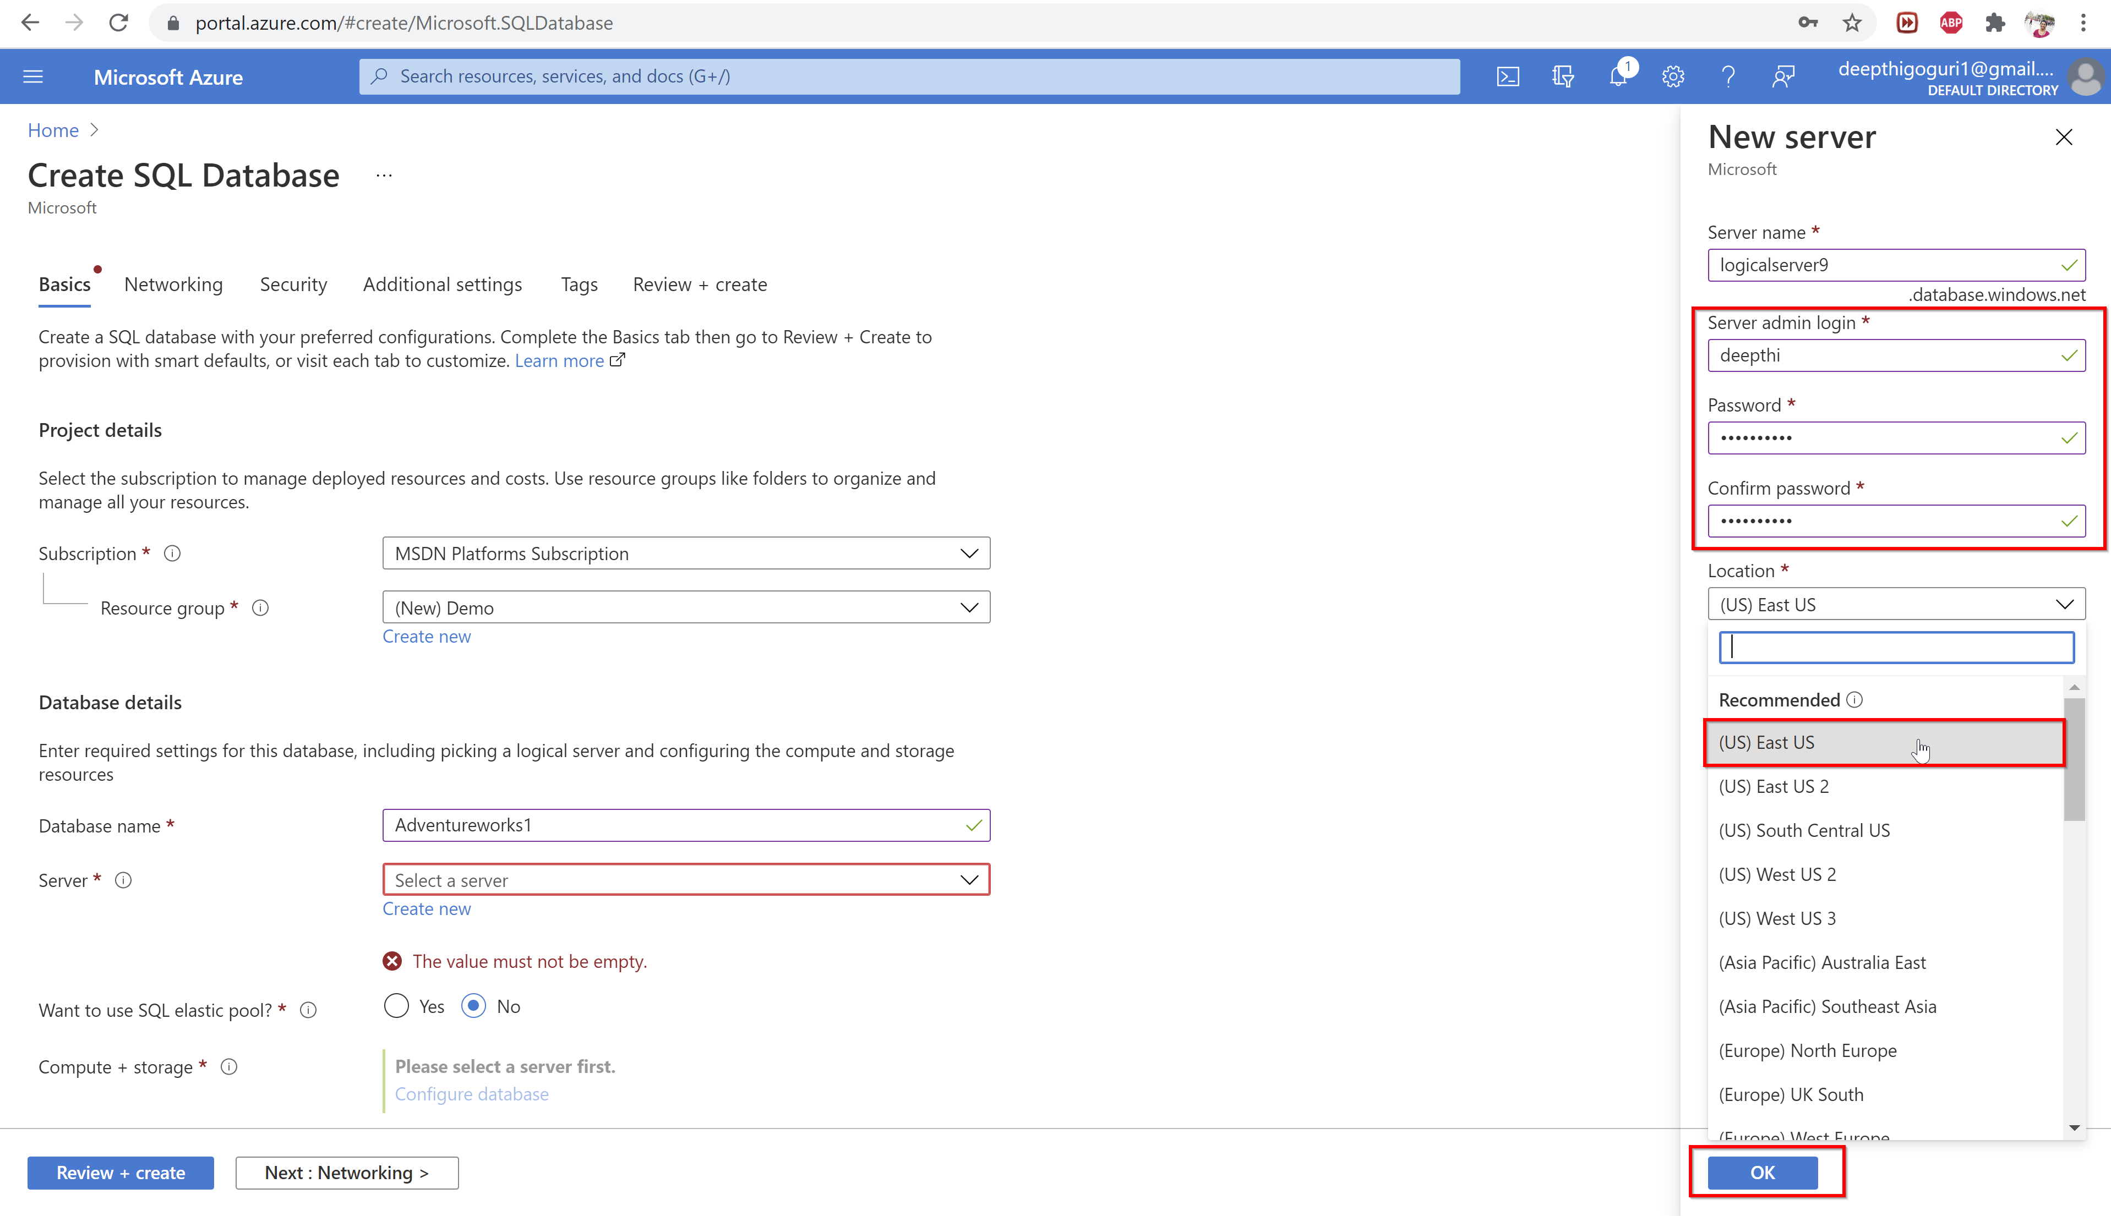

Slide 24
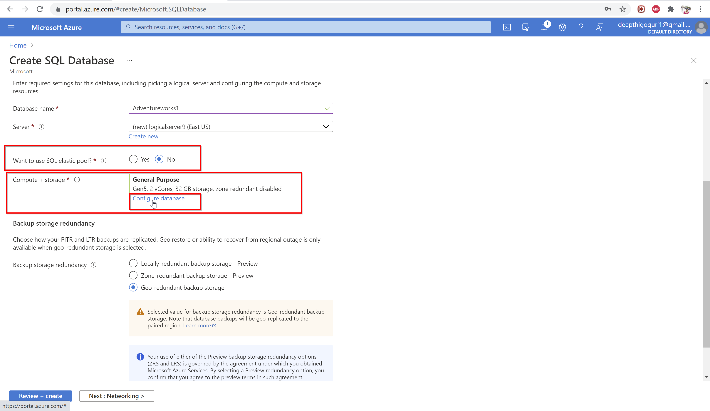

Slide 25
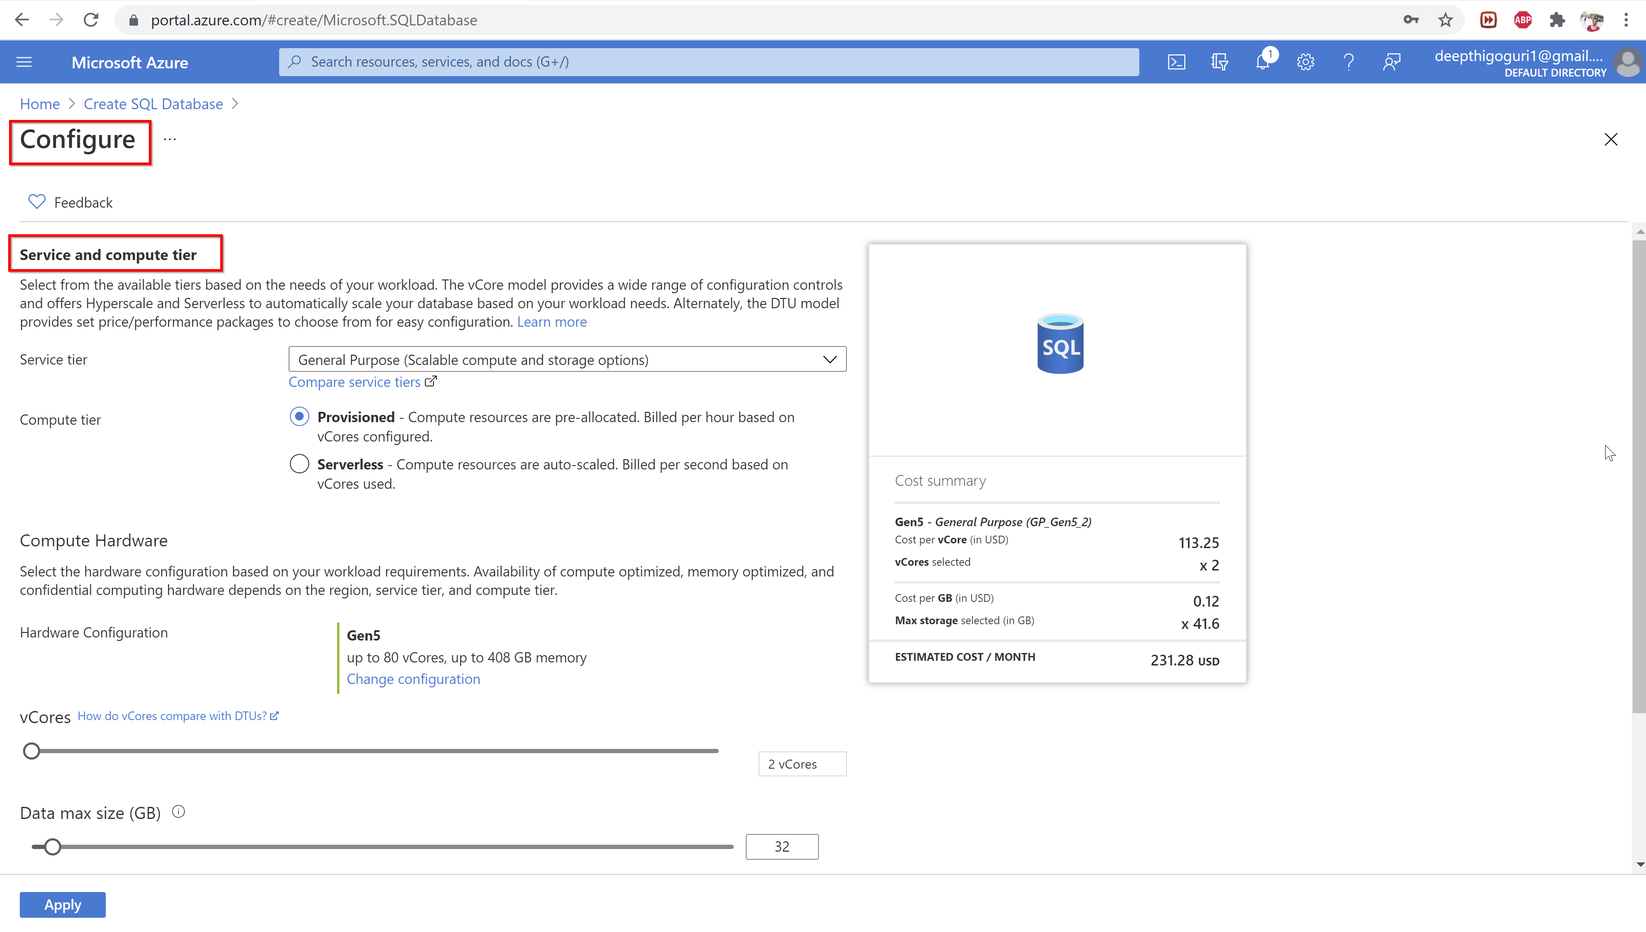

Slide 26
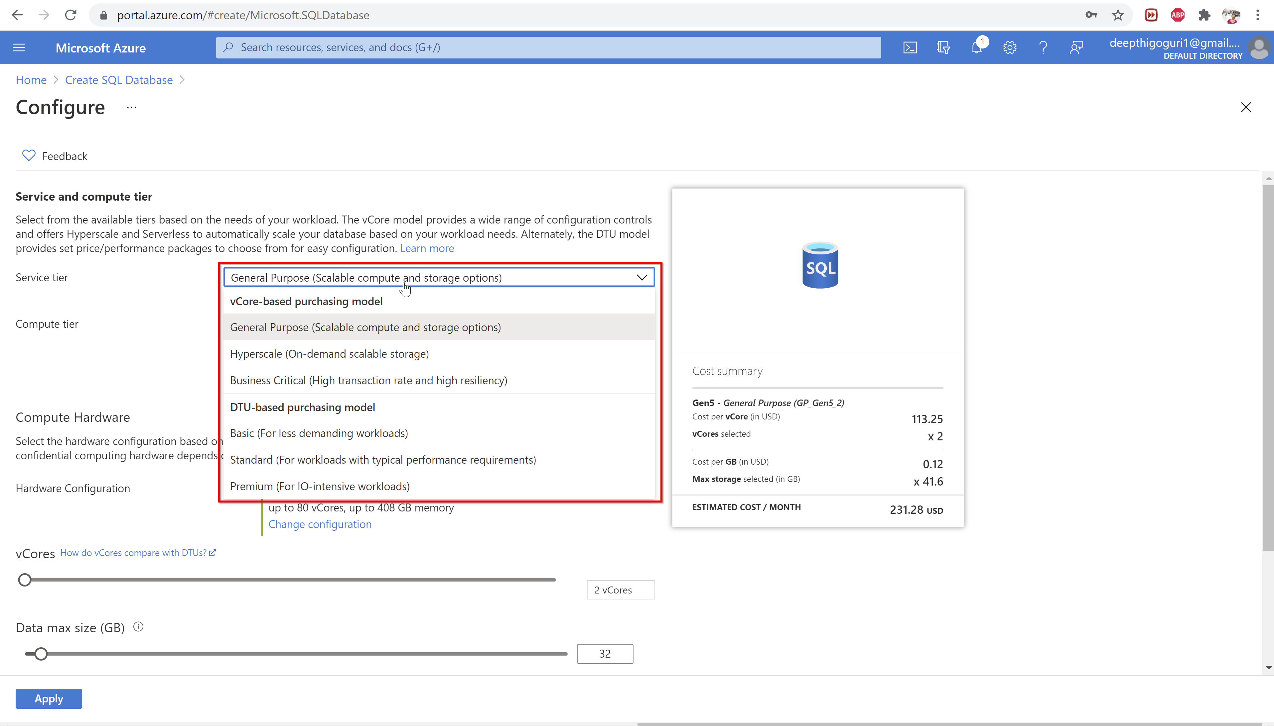

Slide 27
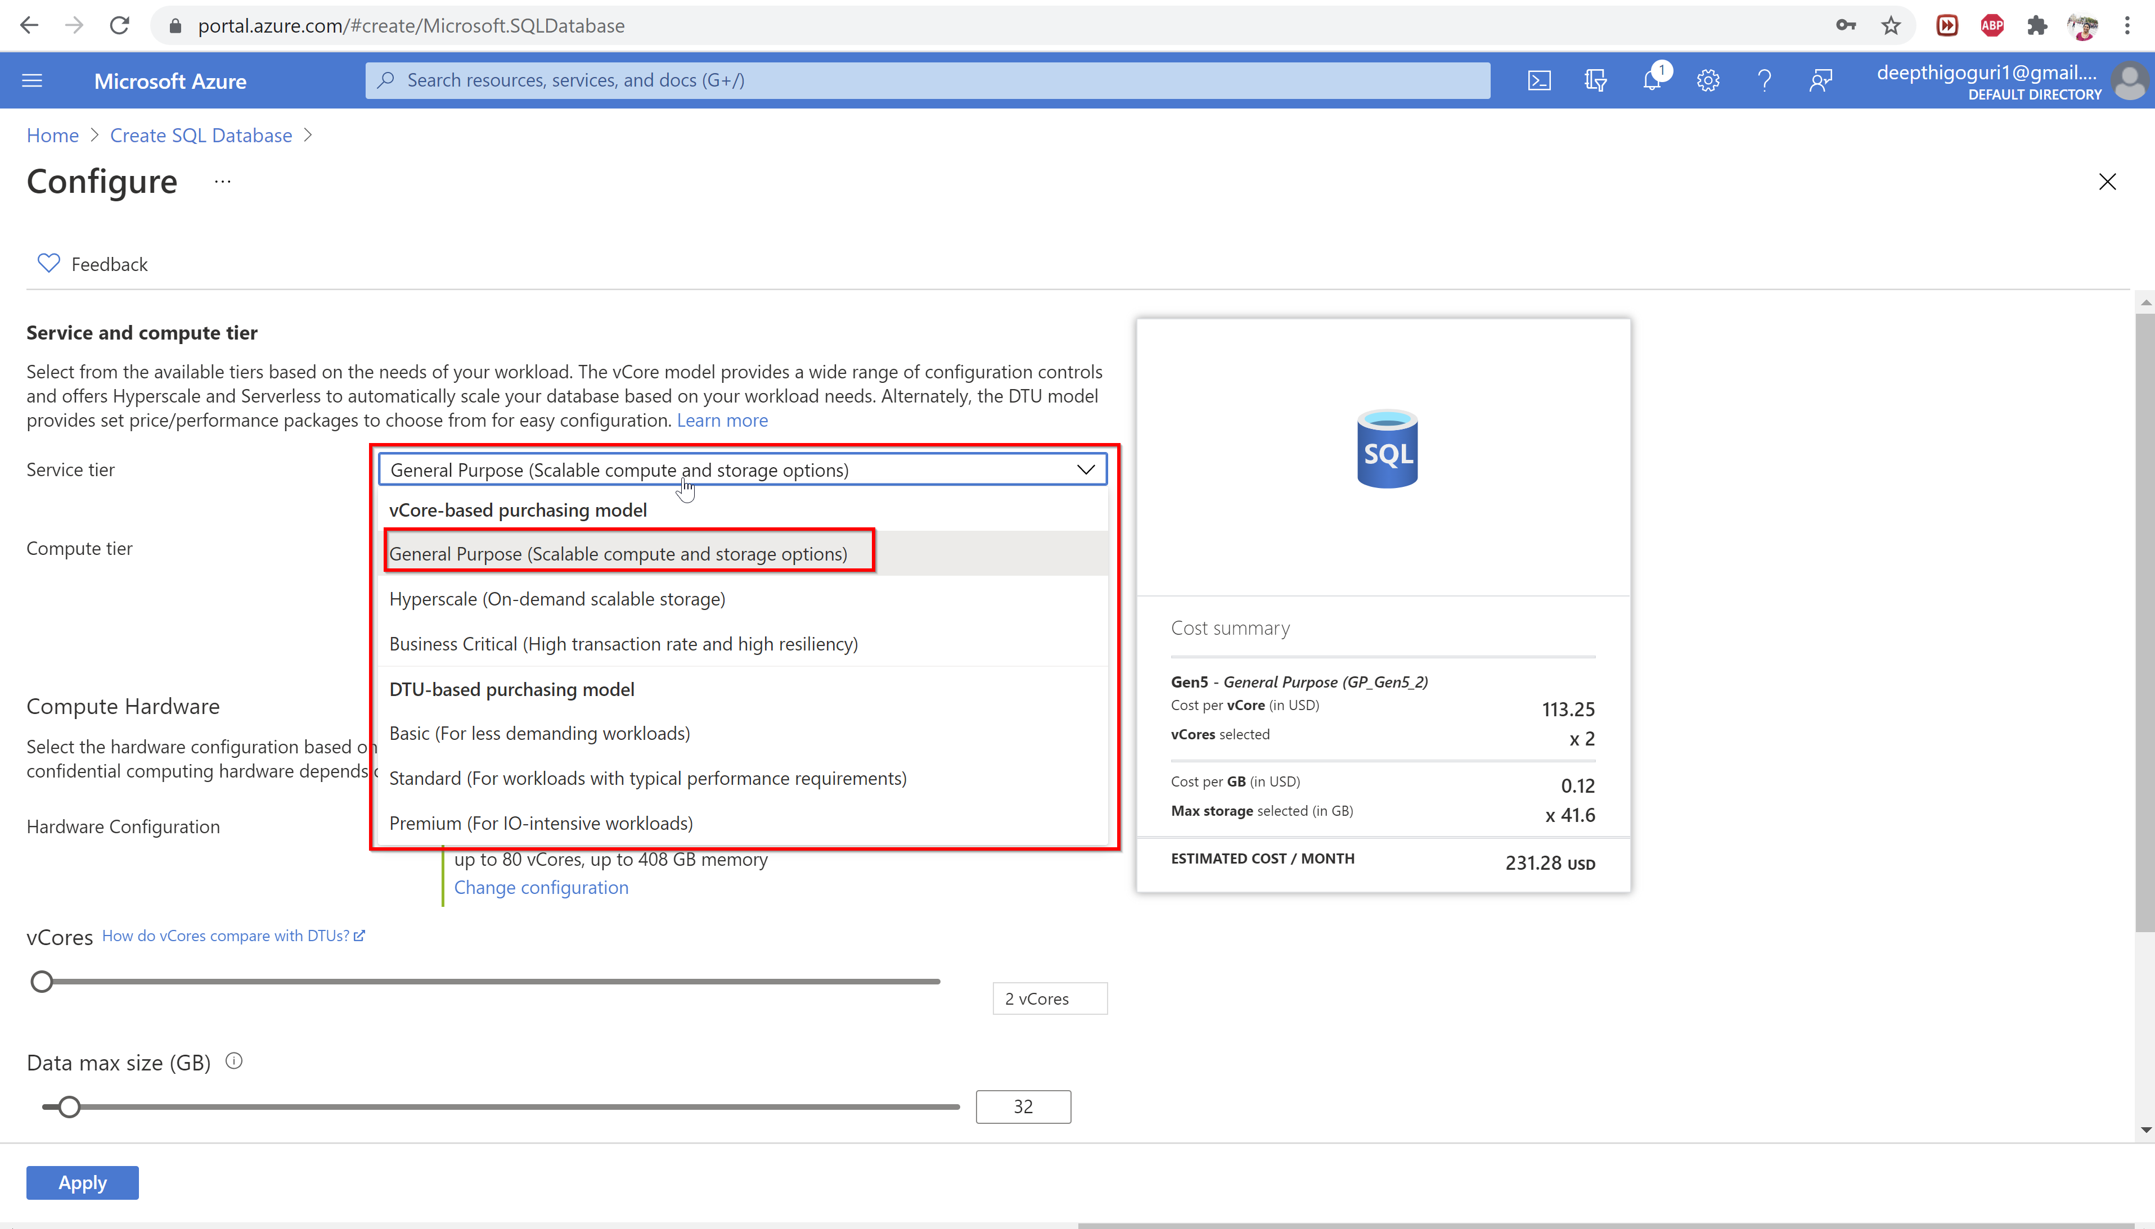

Slide 28
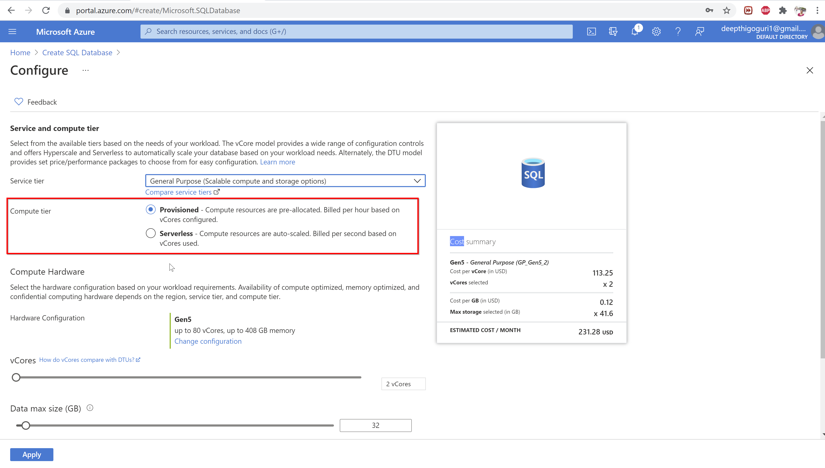

Slide 29
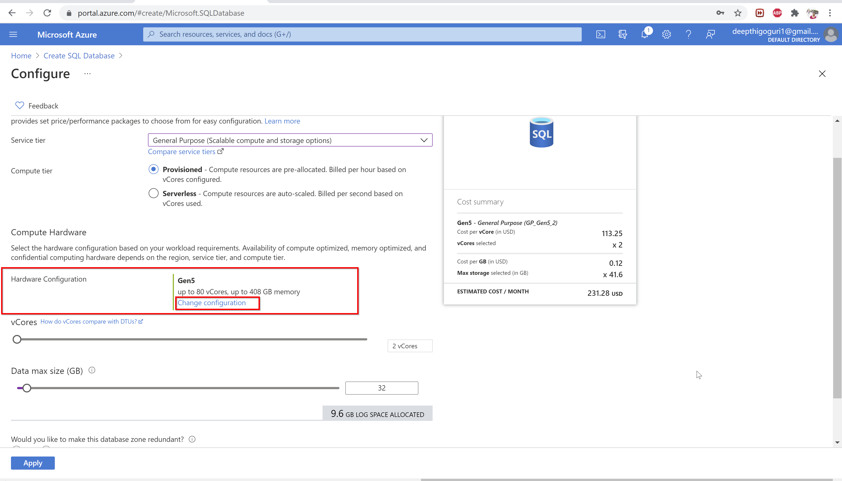

Slide 30
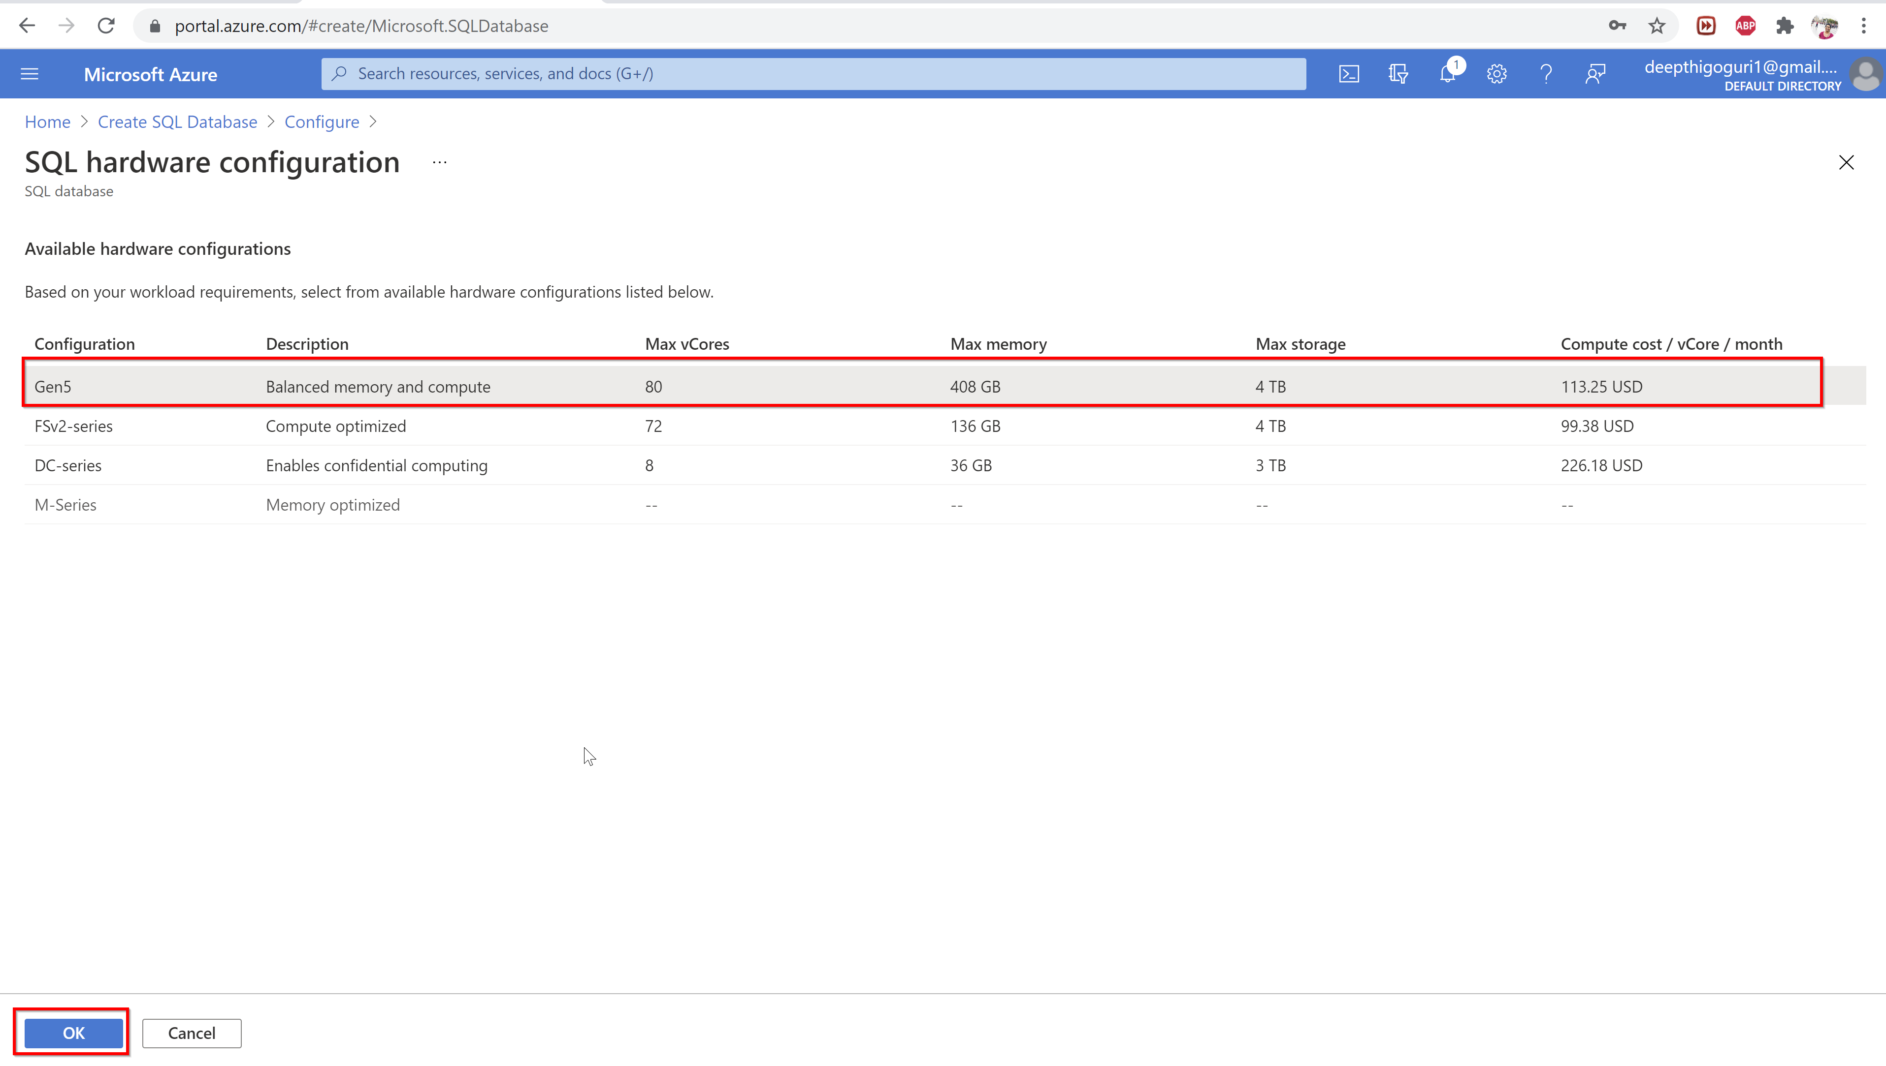

Slide 31
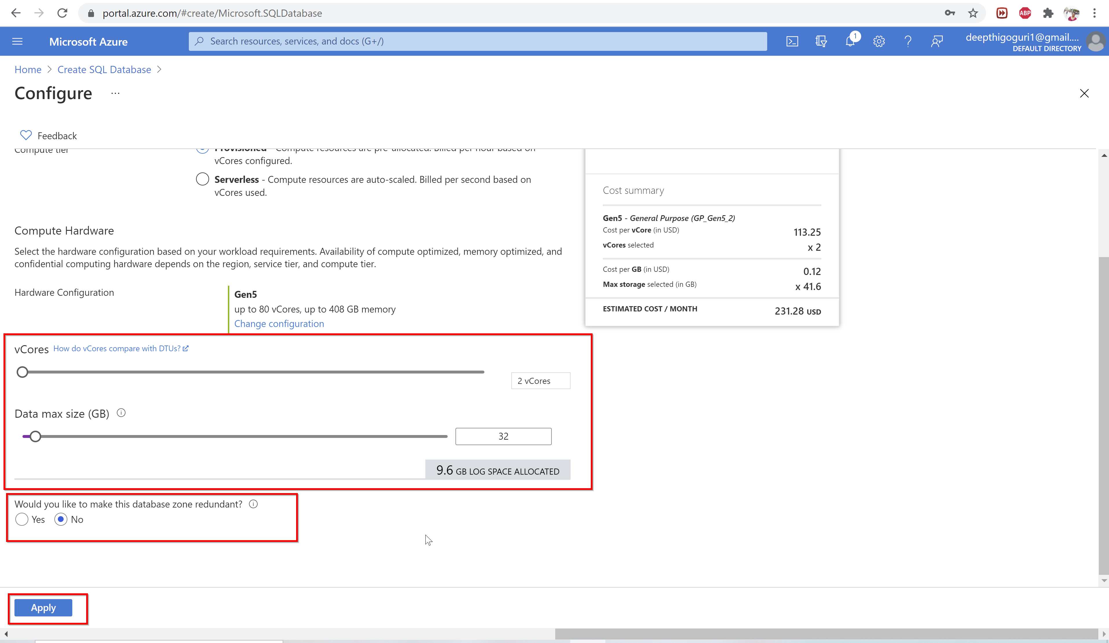

Slide 32
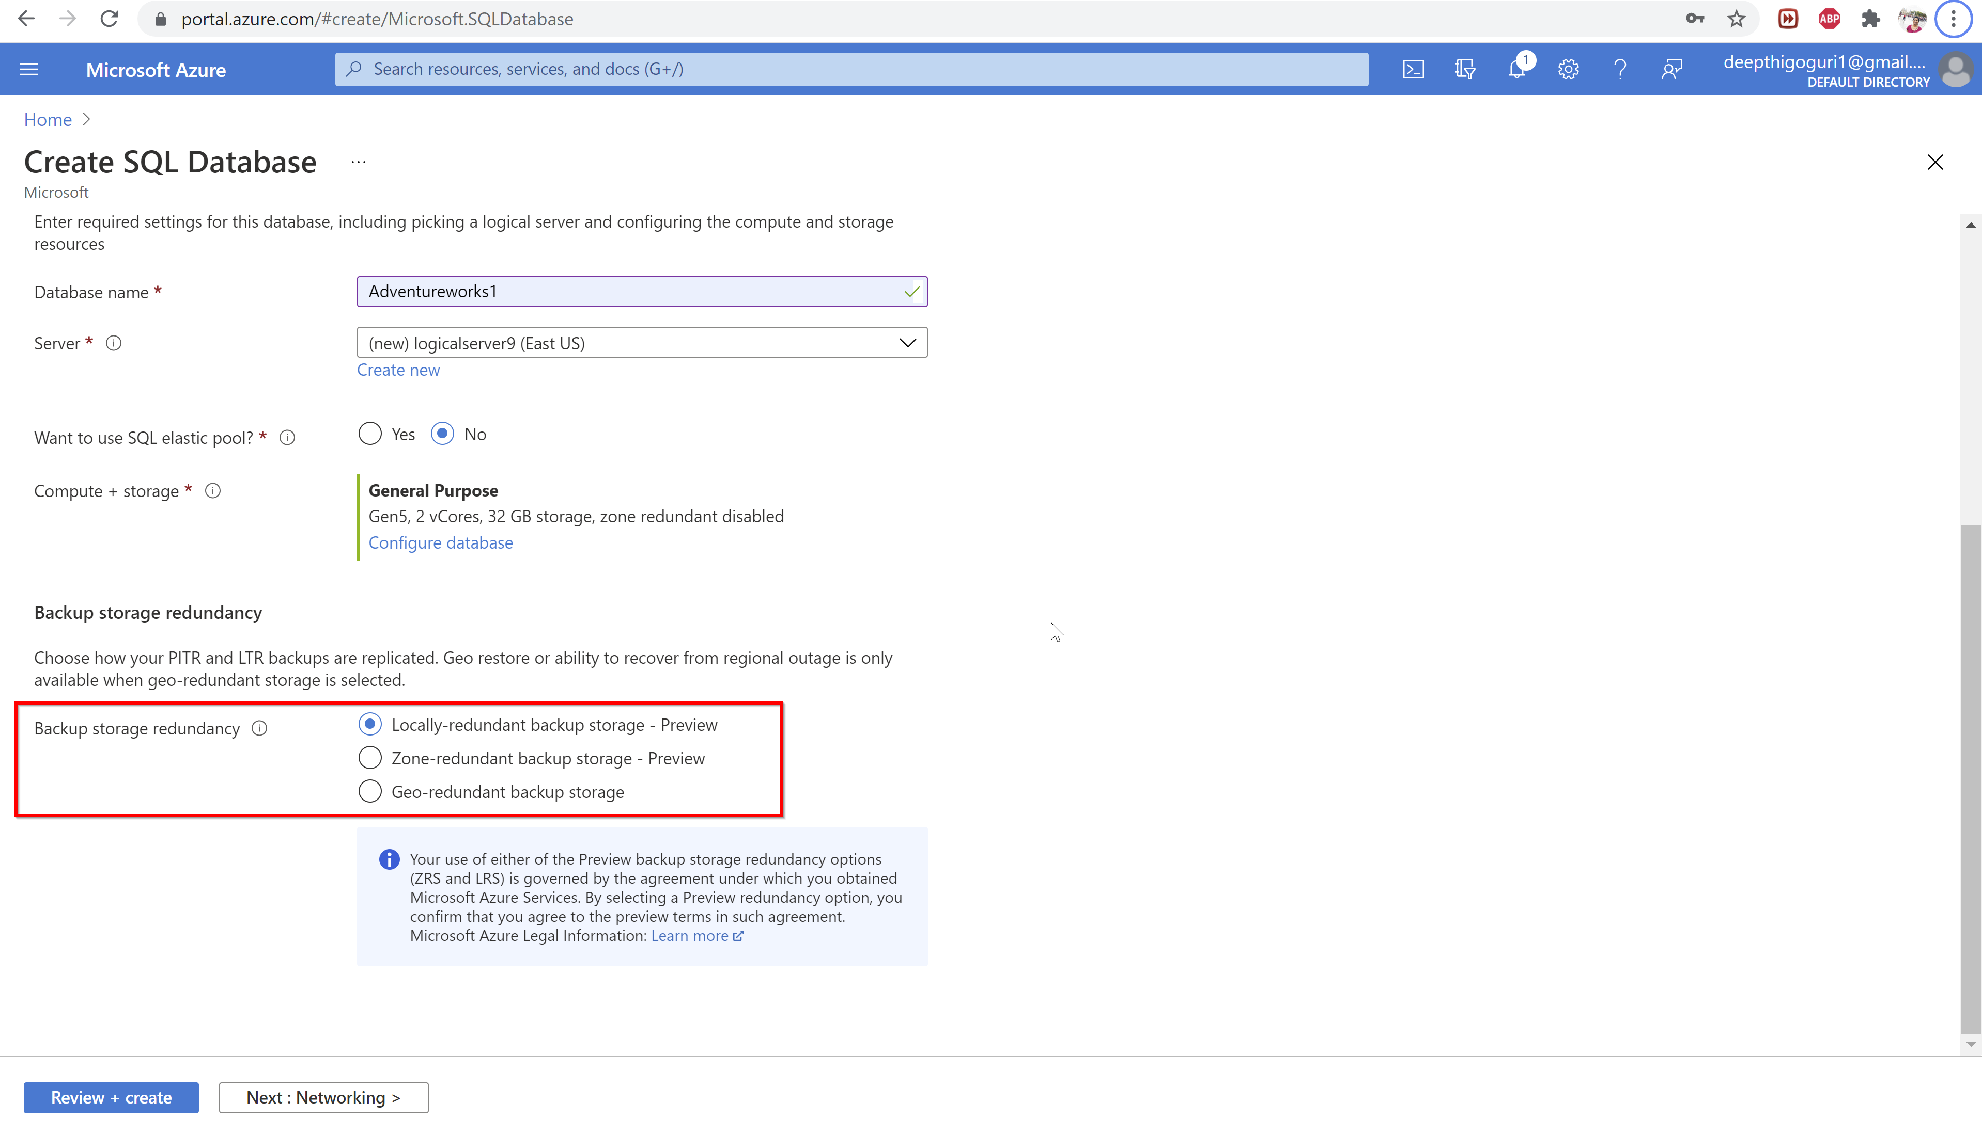

Slide 33
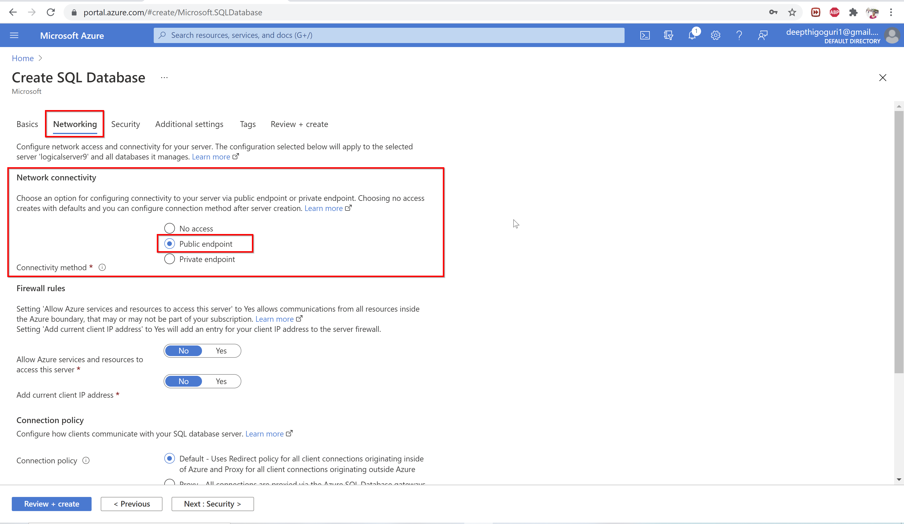

Slide 34
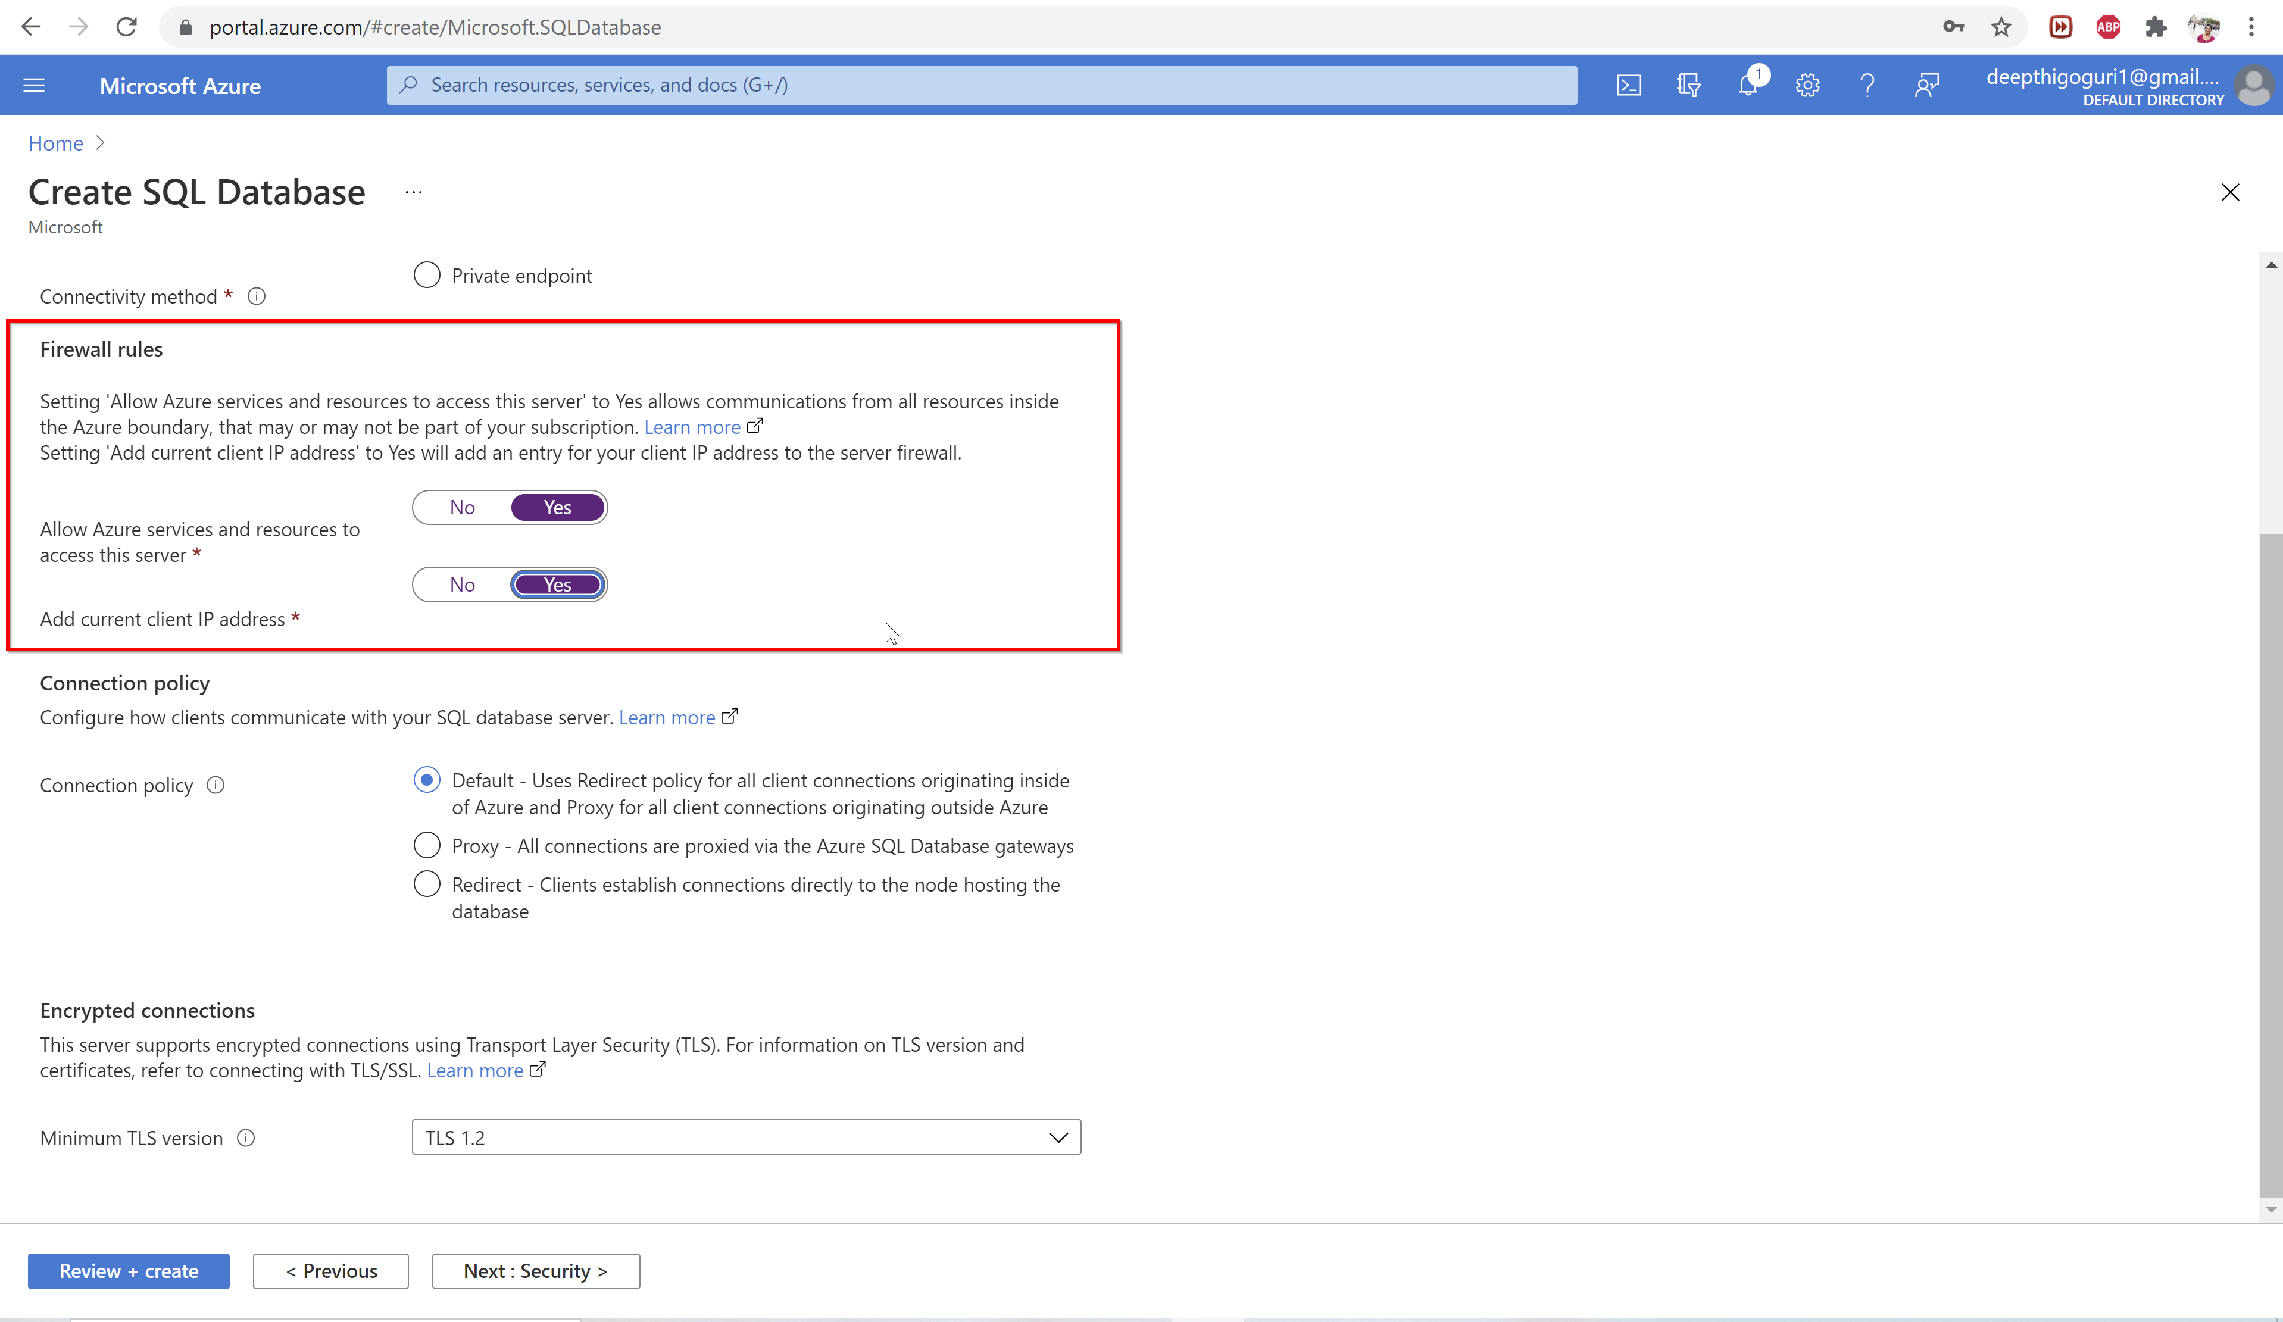

Slide 35
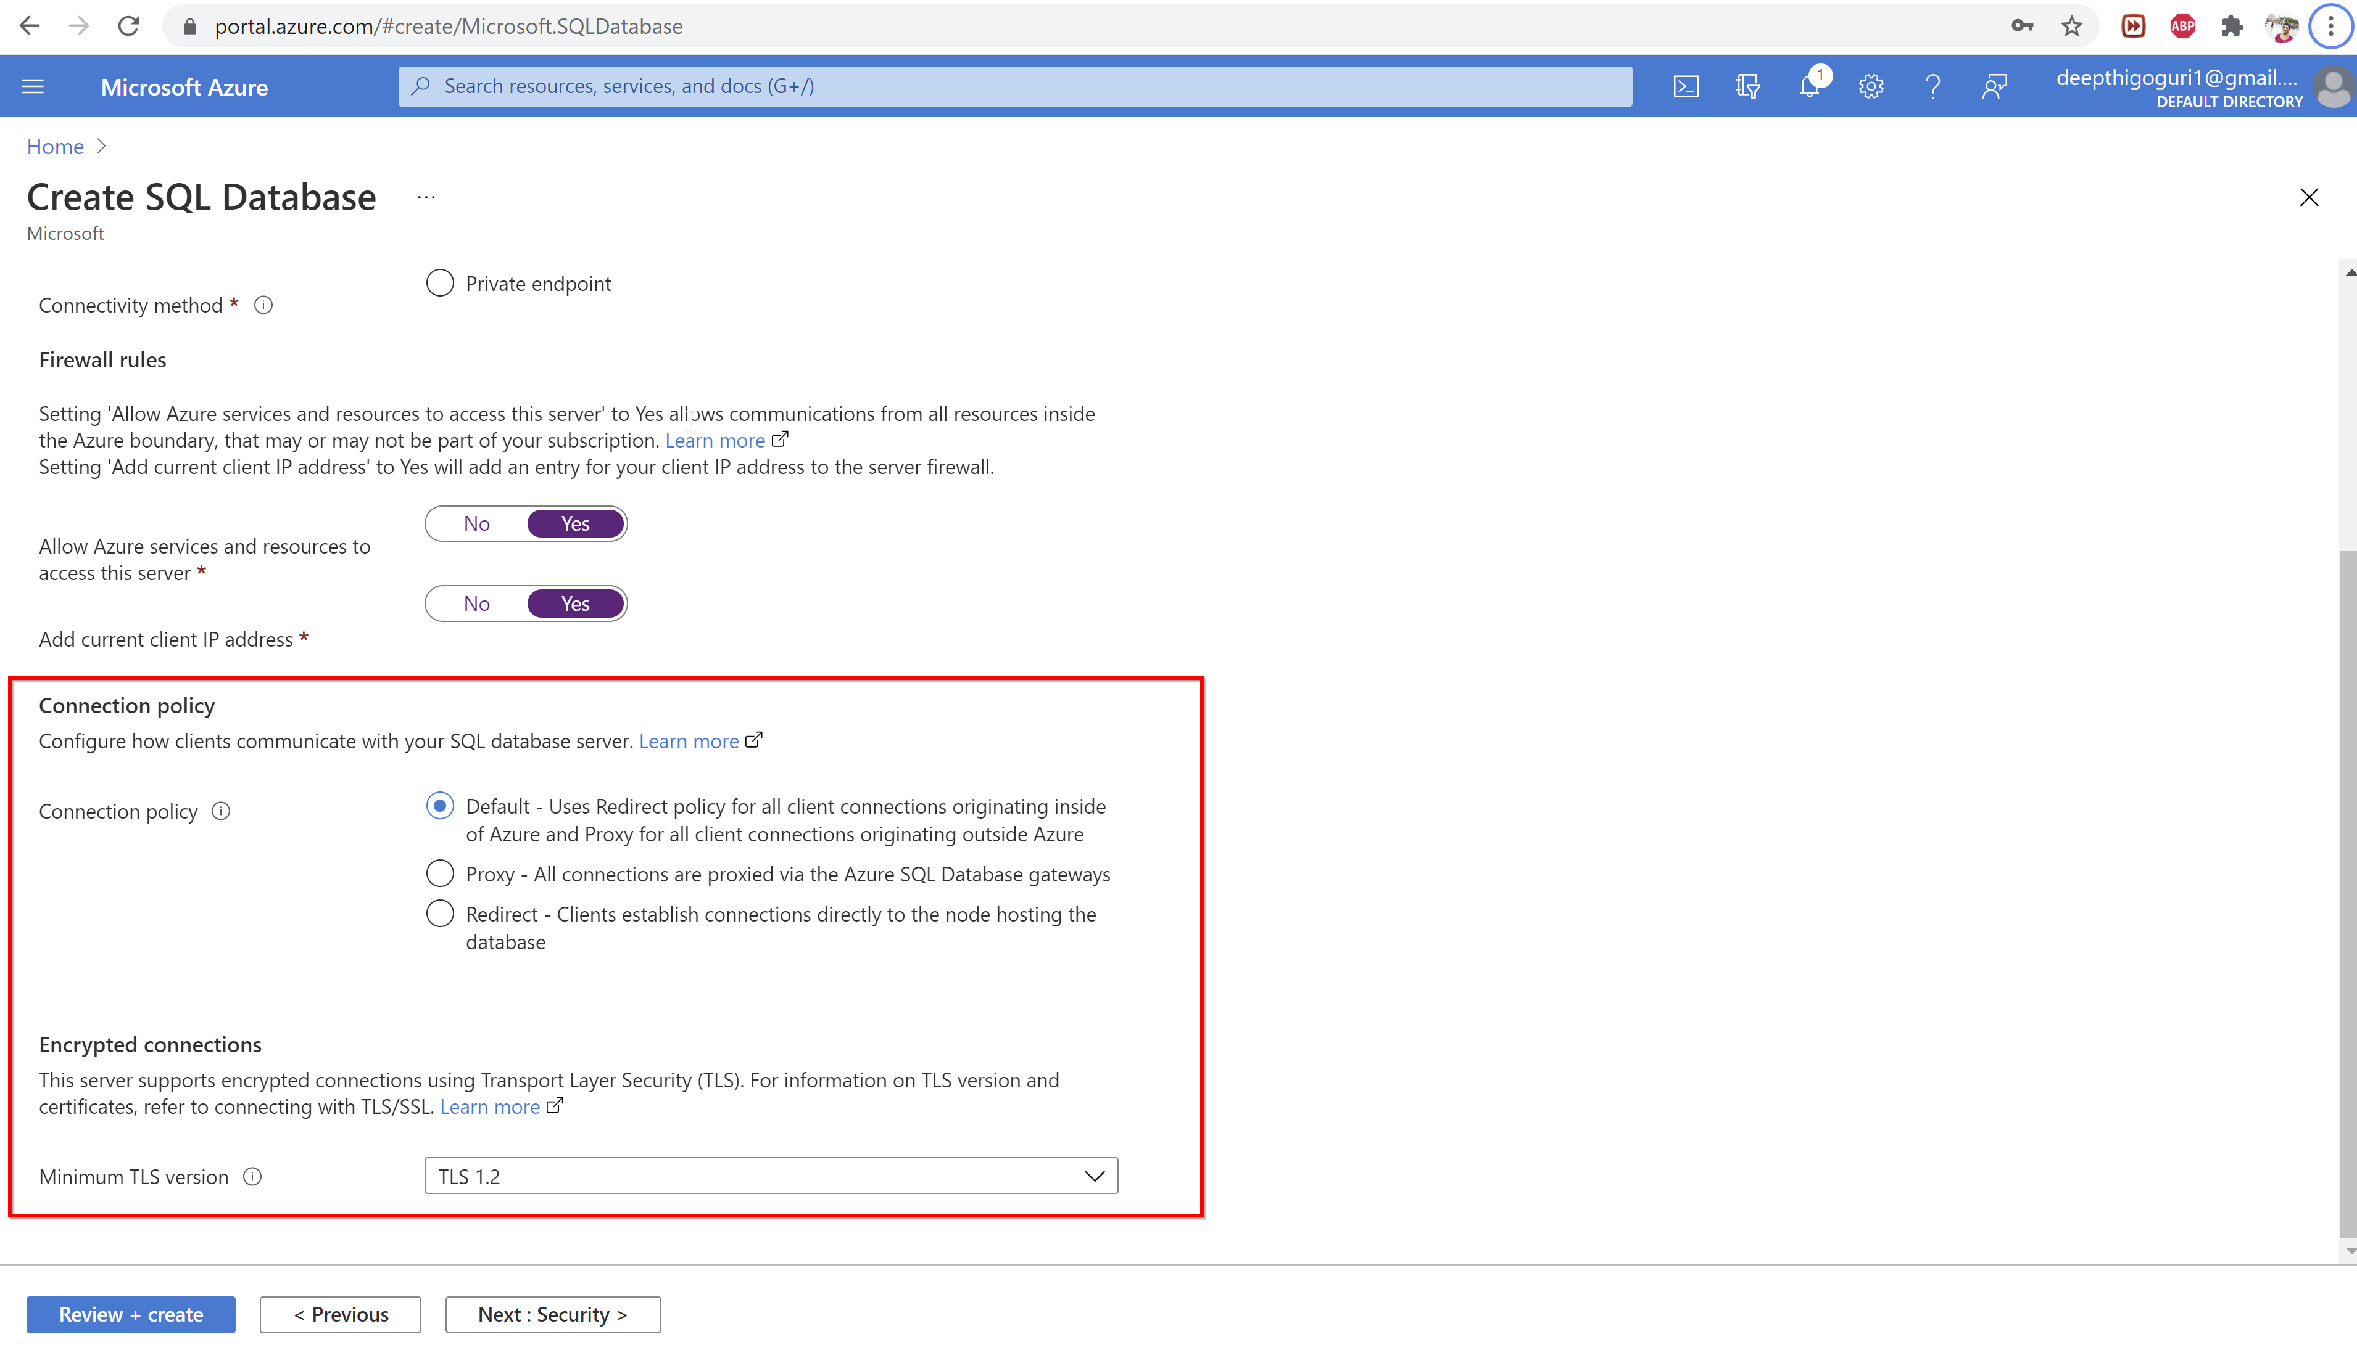

Slide 36
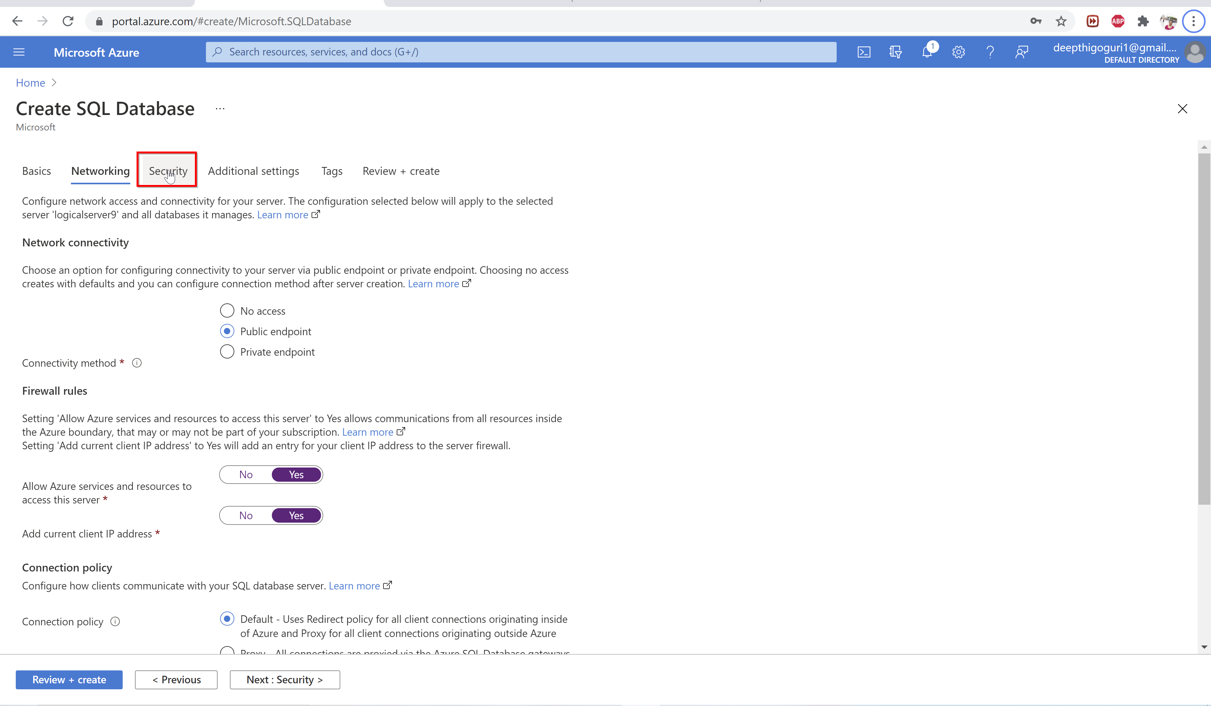

Slide 37
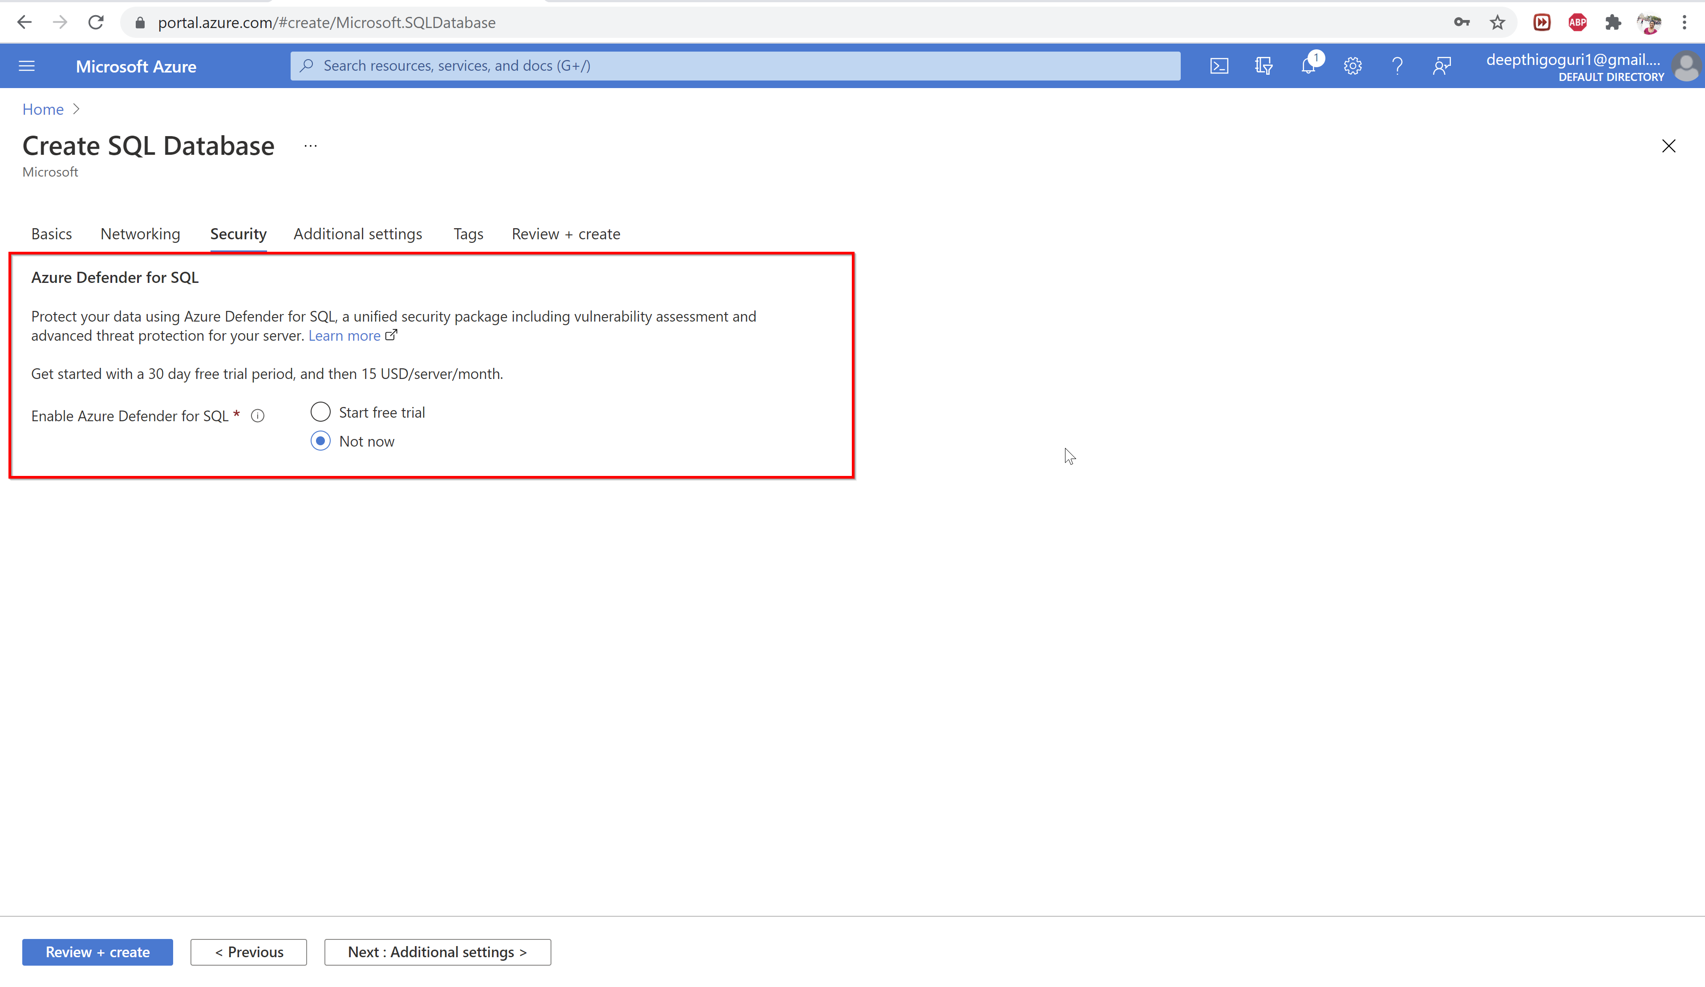

Slide 38
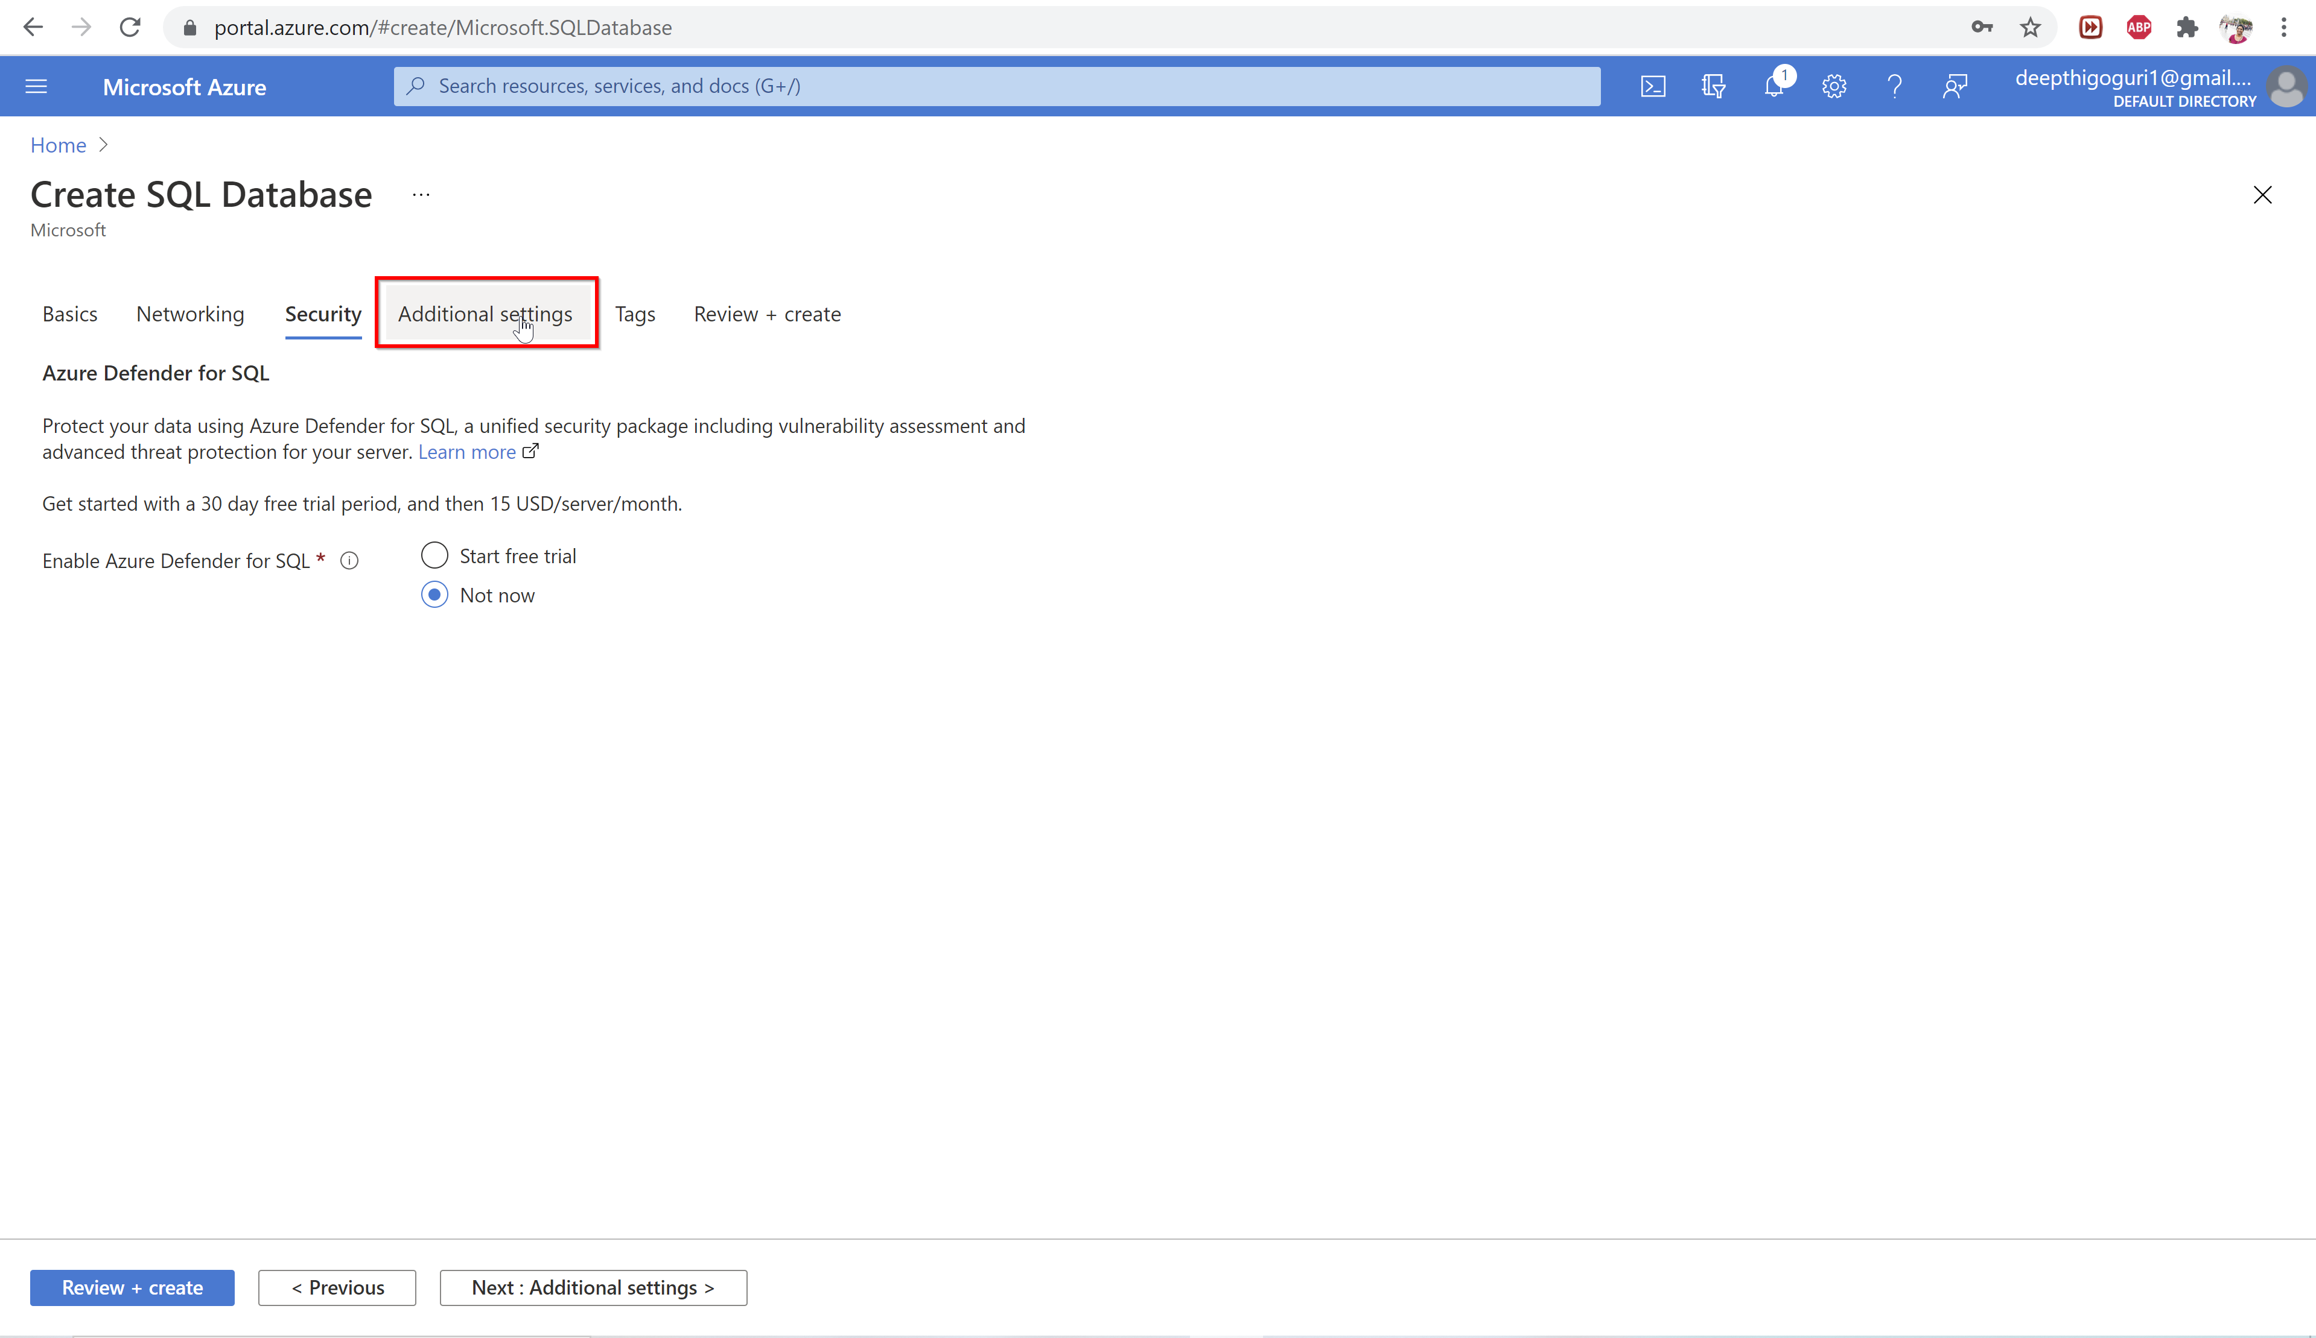

Slide 39
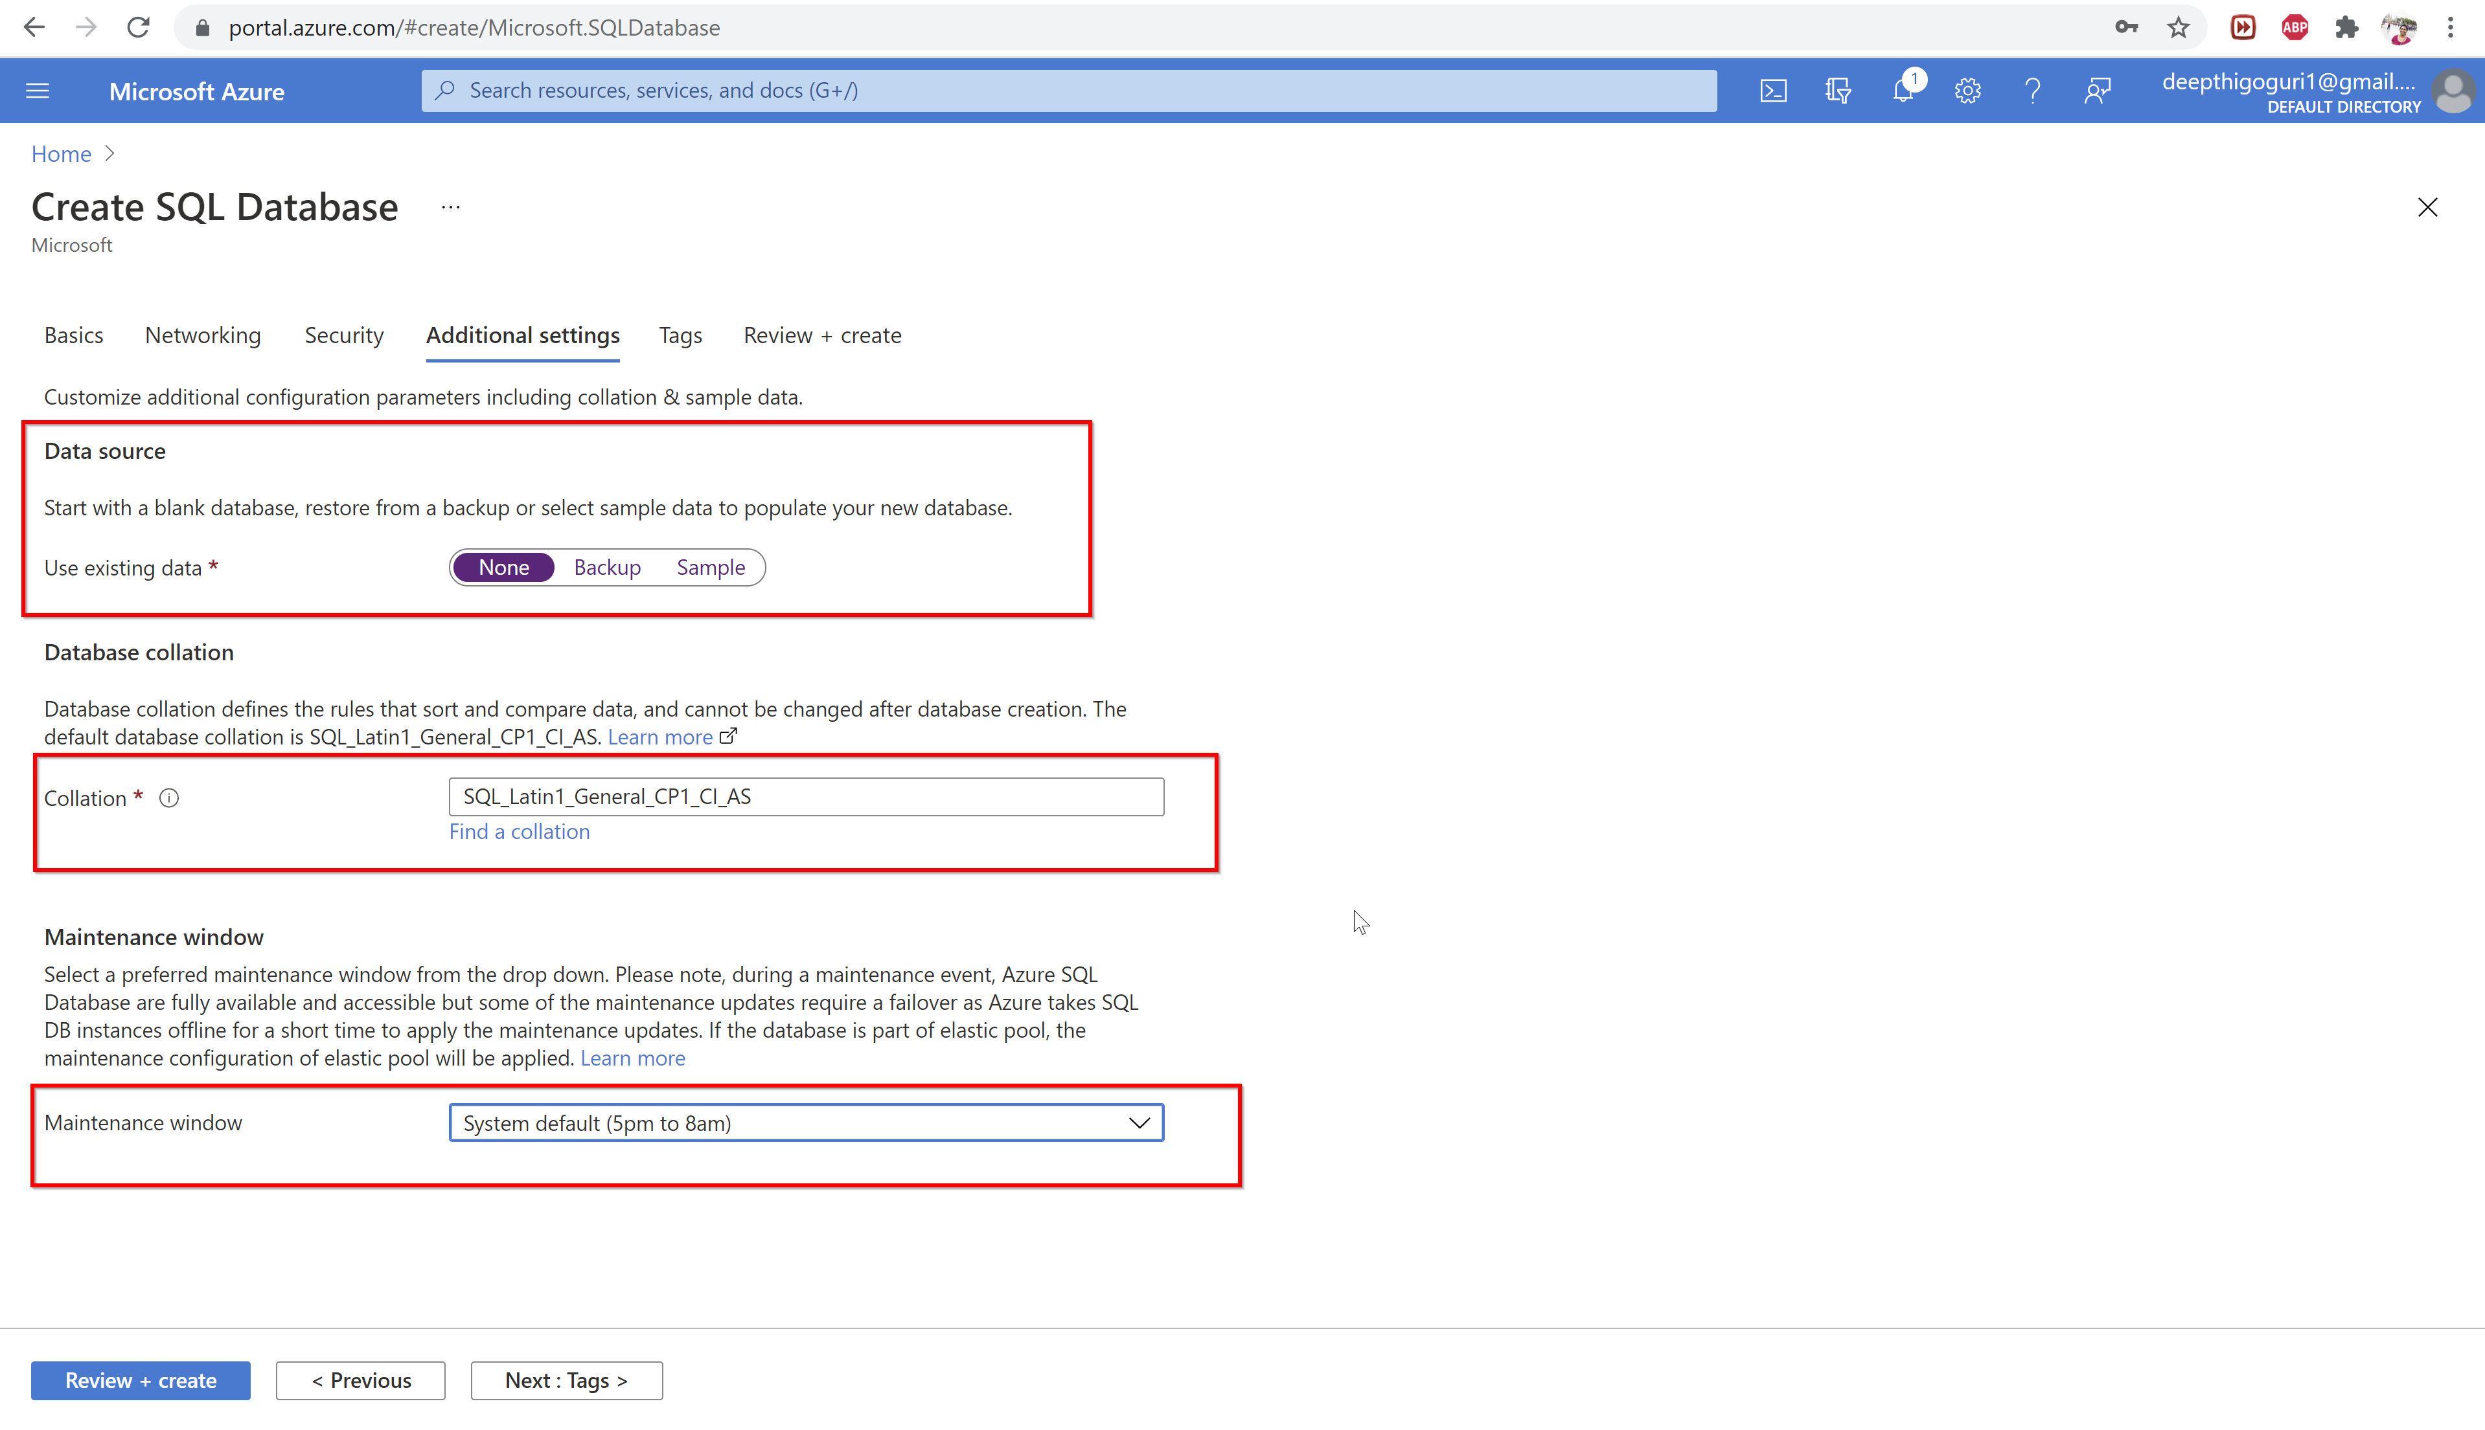

Slide 40
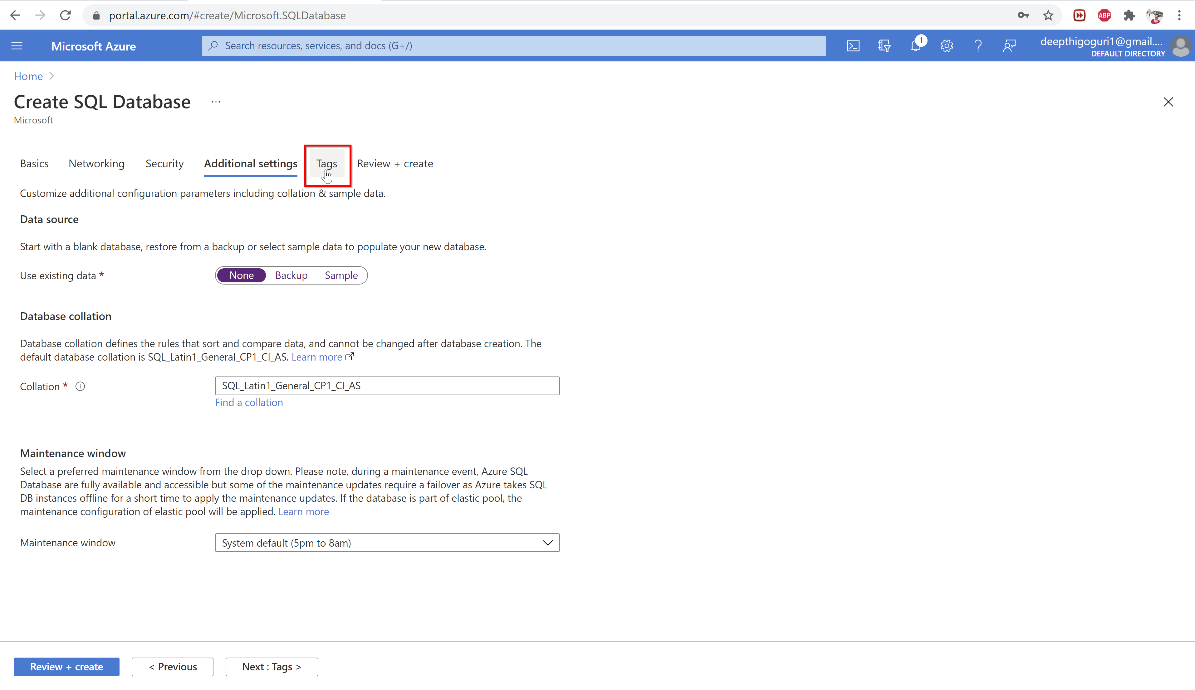

Slide 41
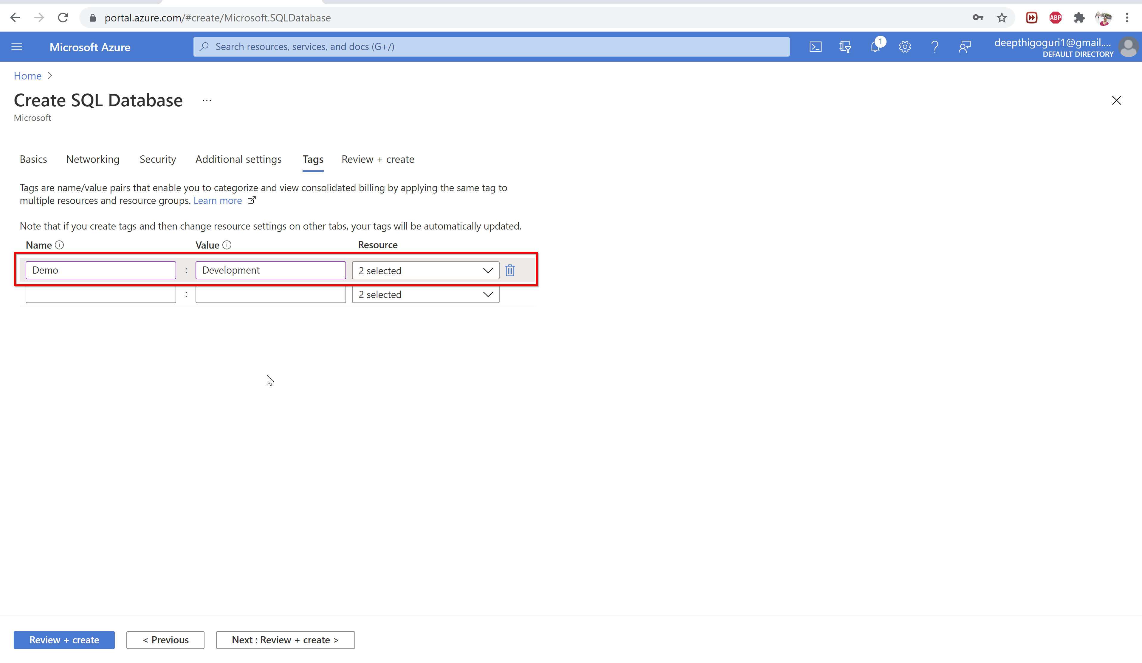

Slide 42
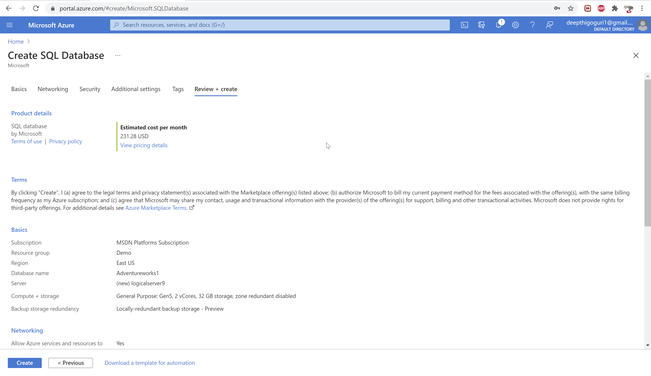

Slide 43
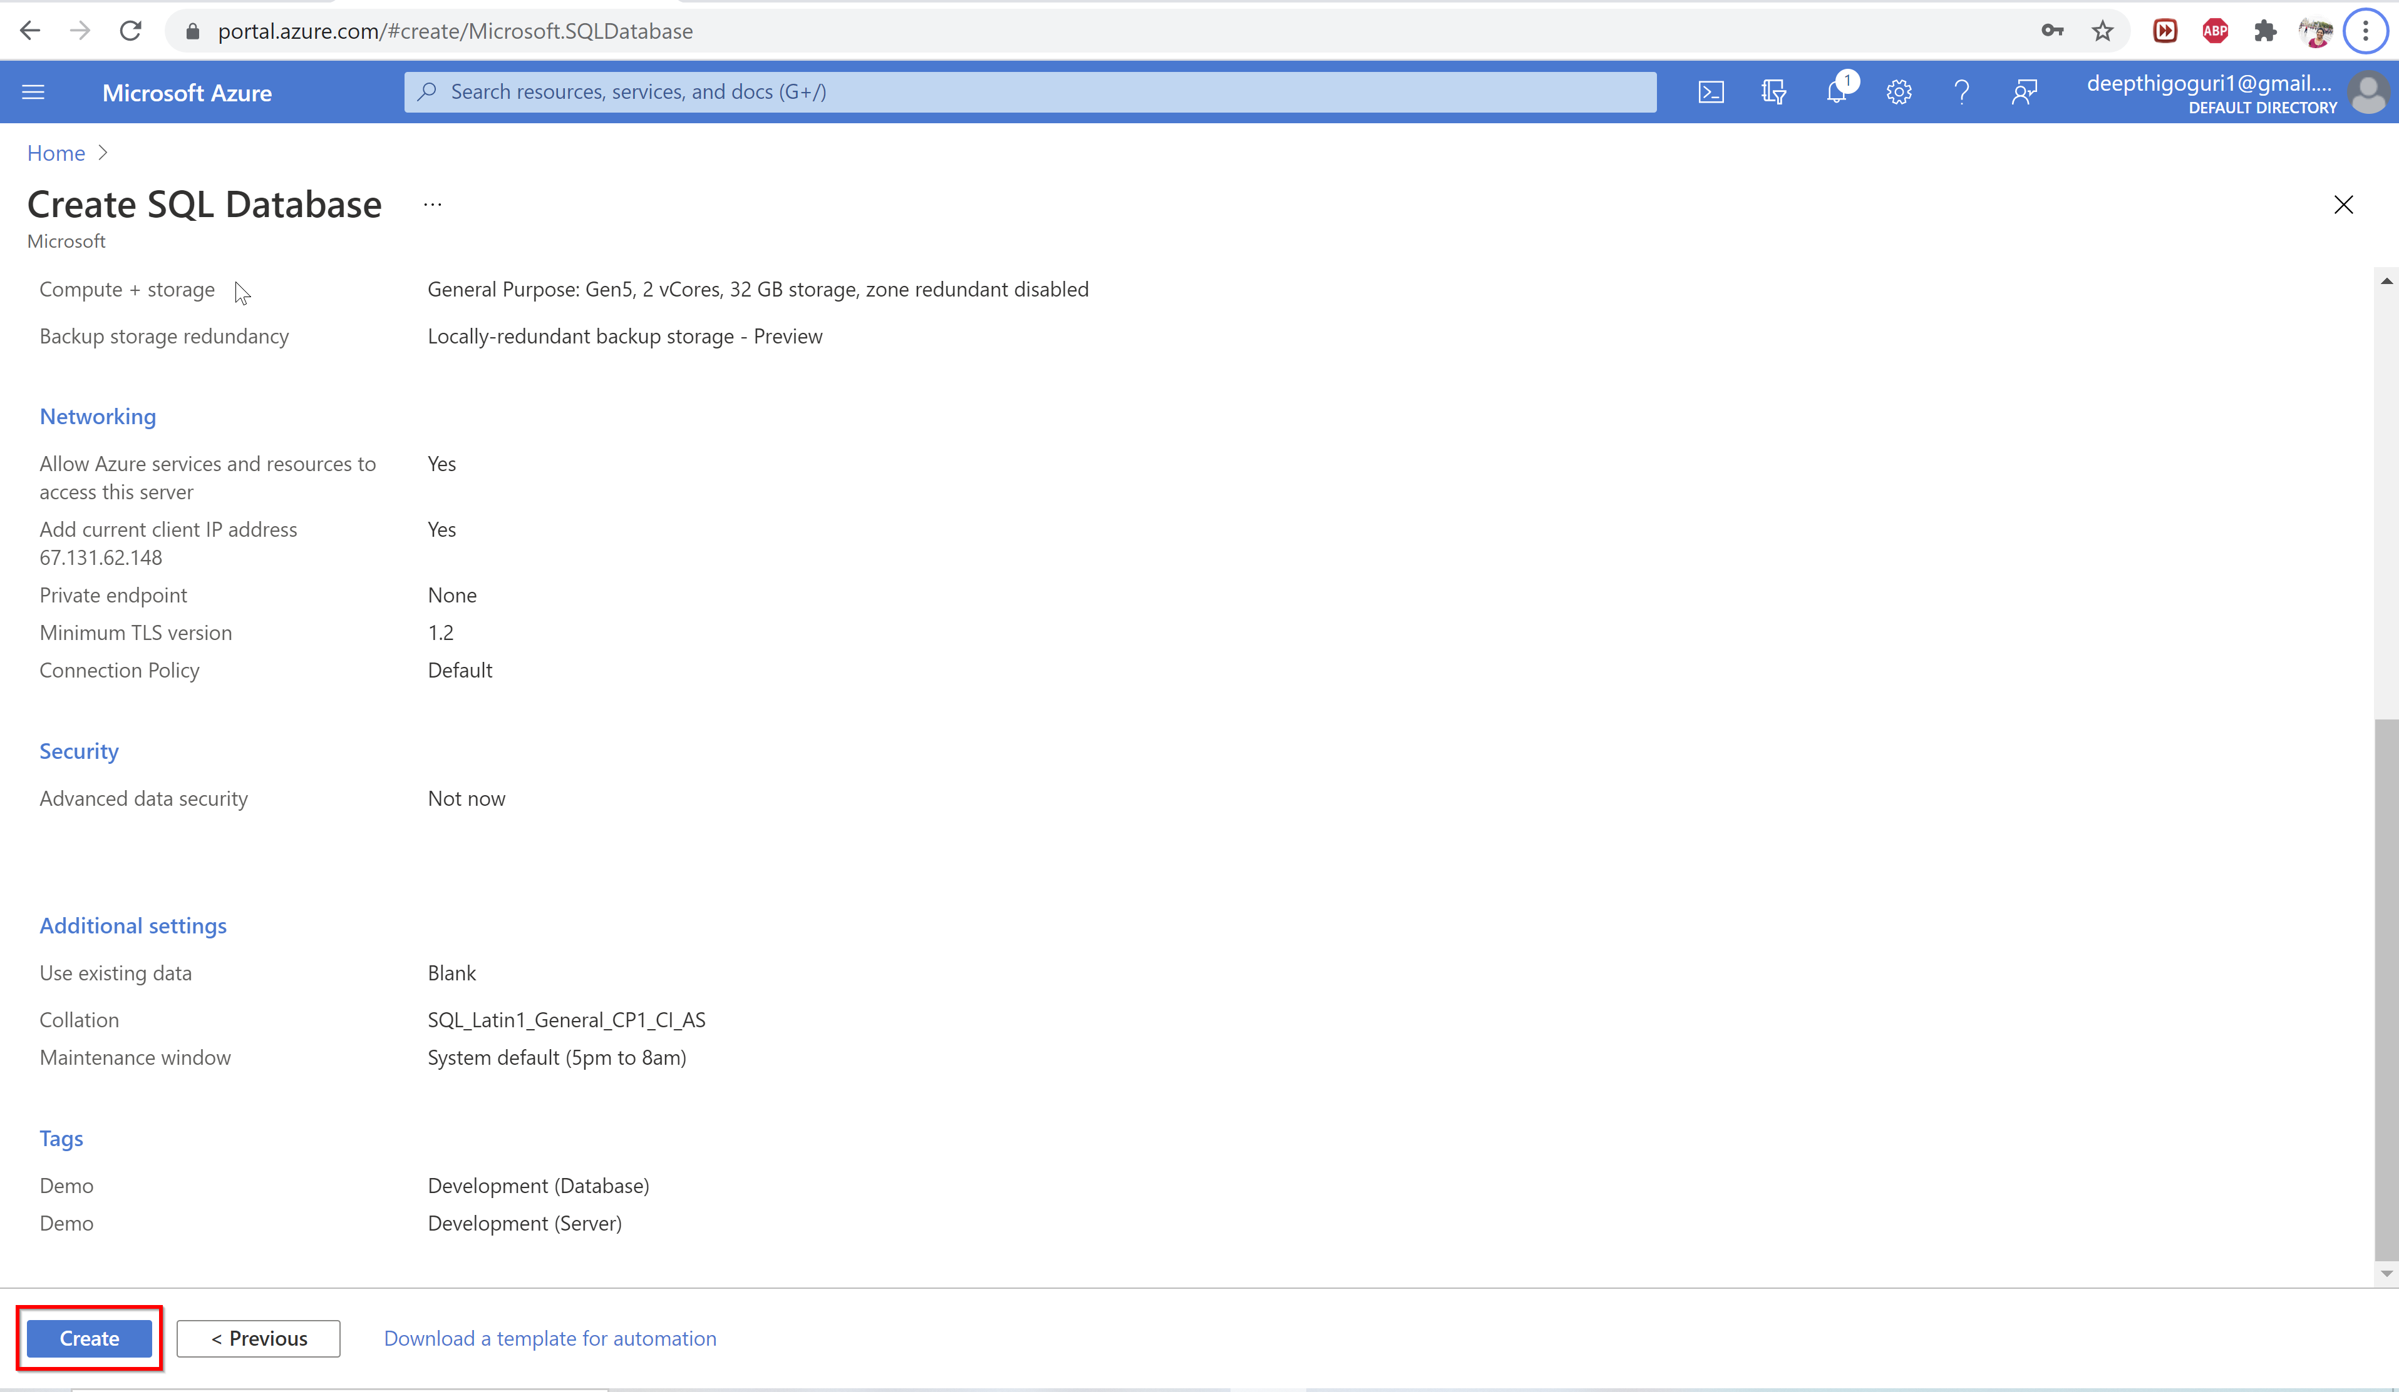

Slide 44
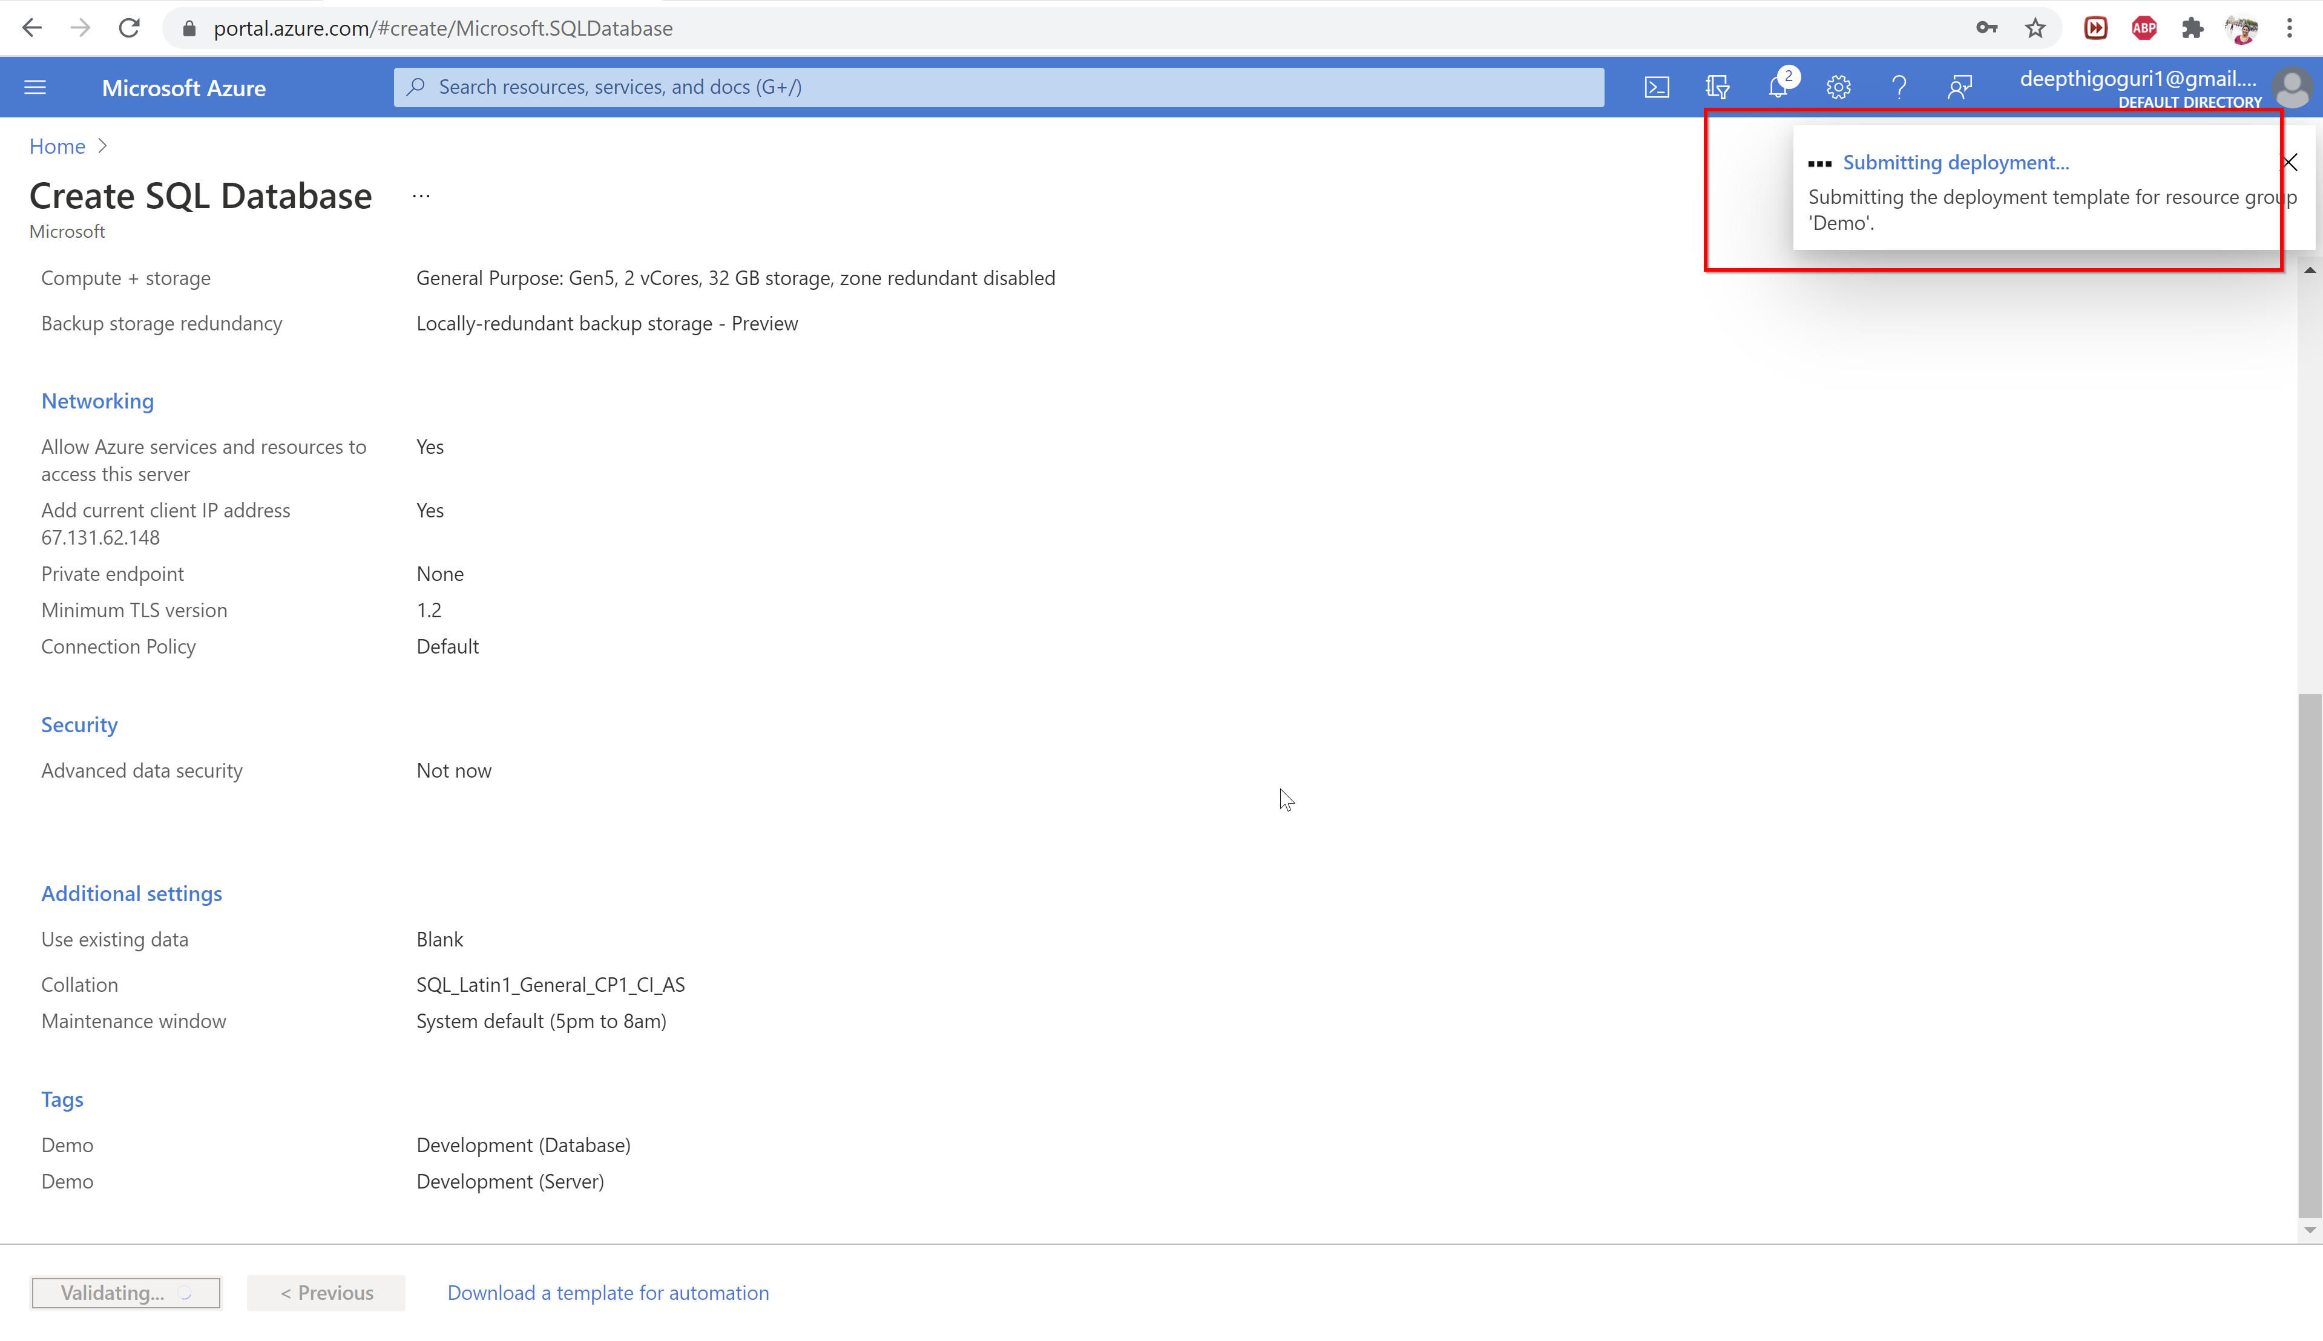

Slide 45
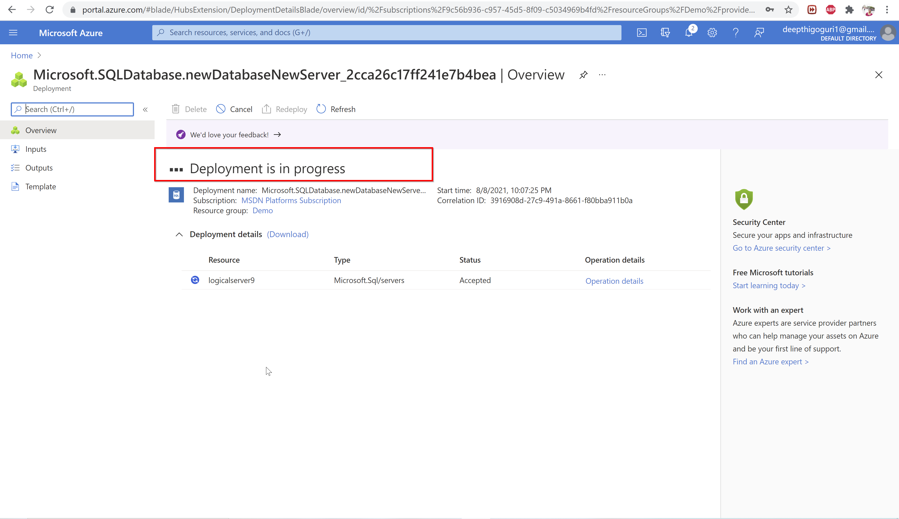

Slide 46
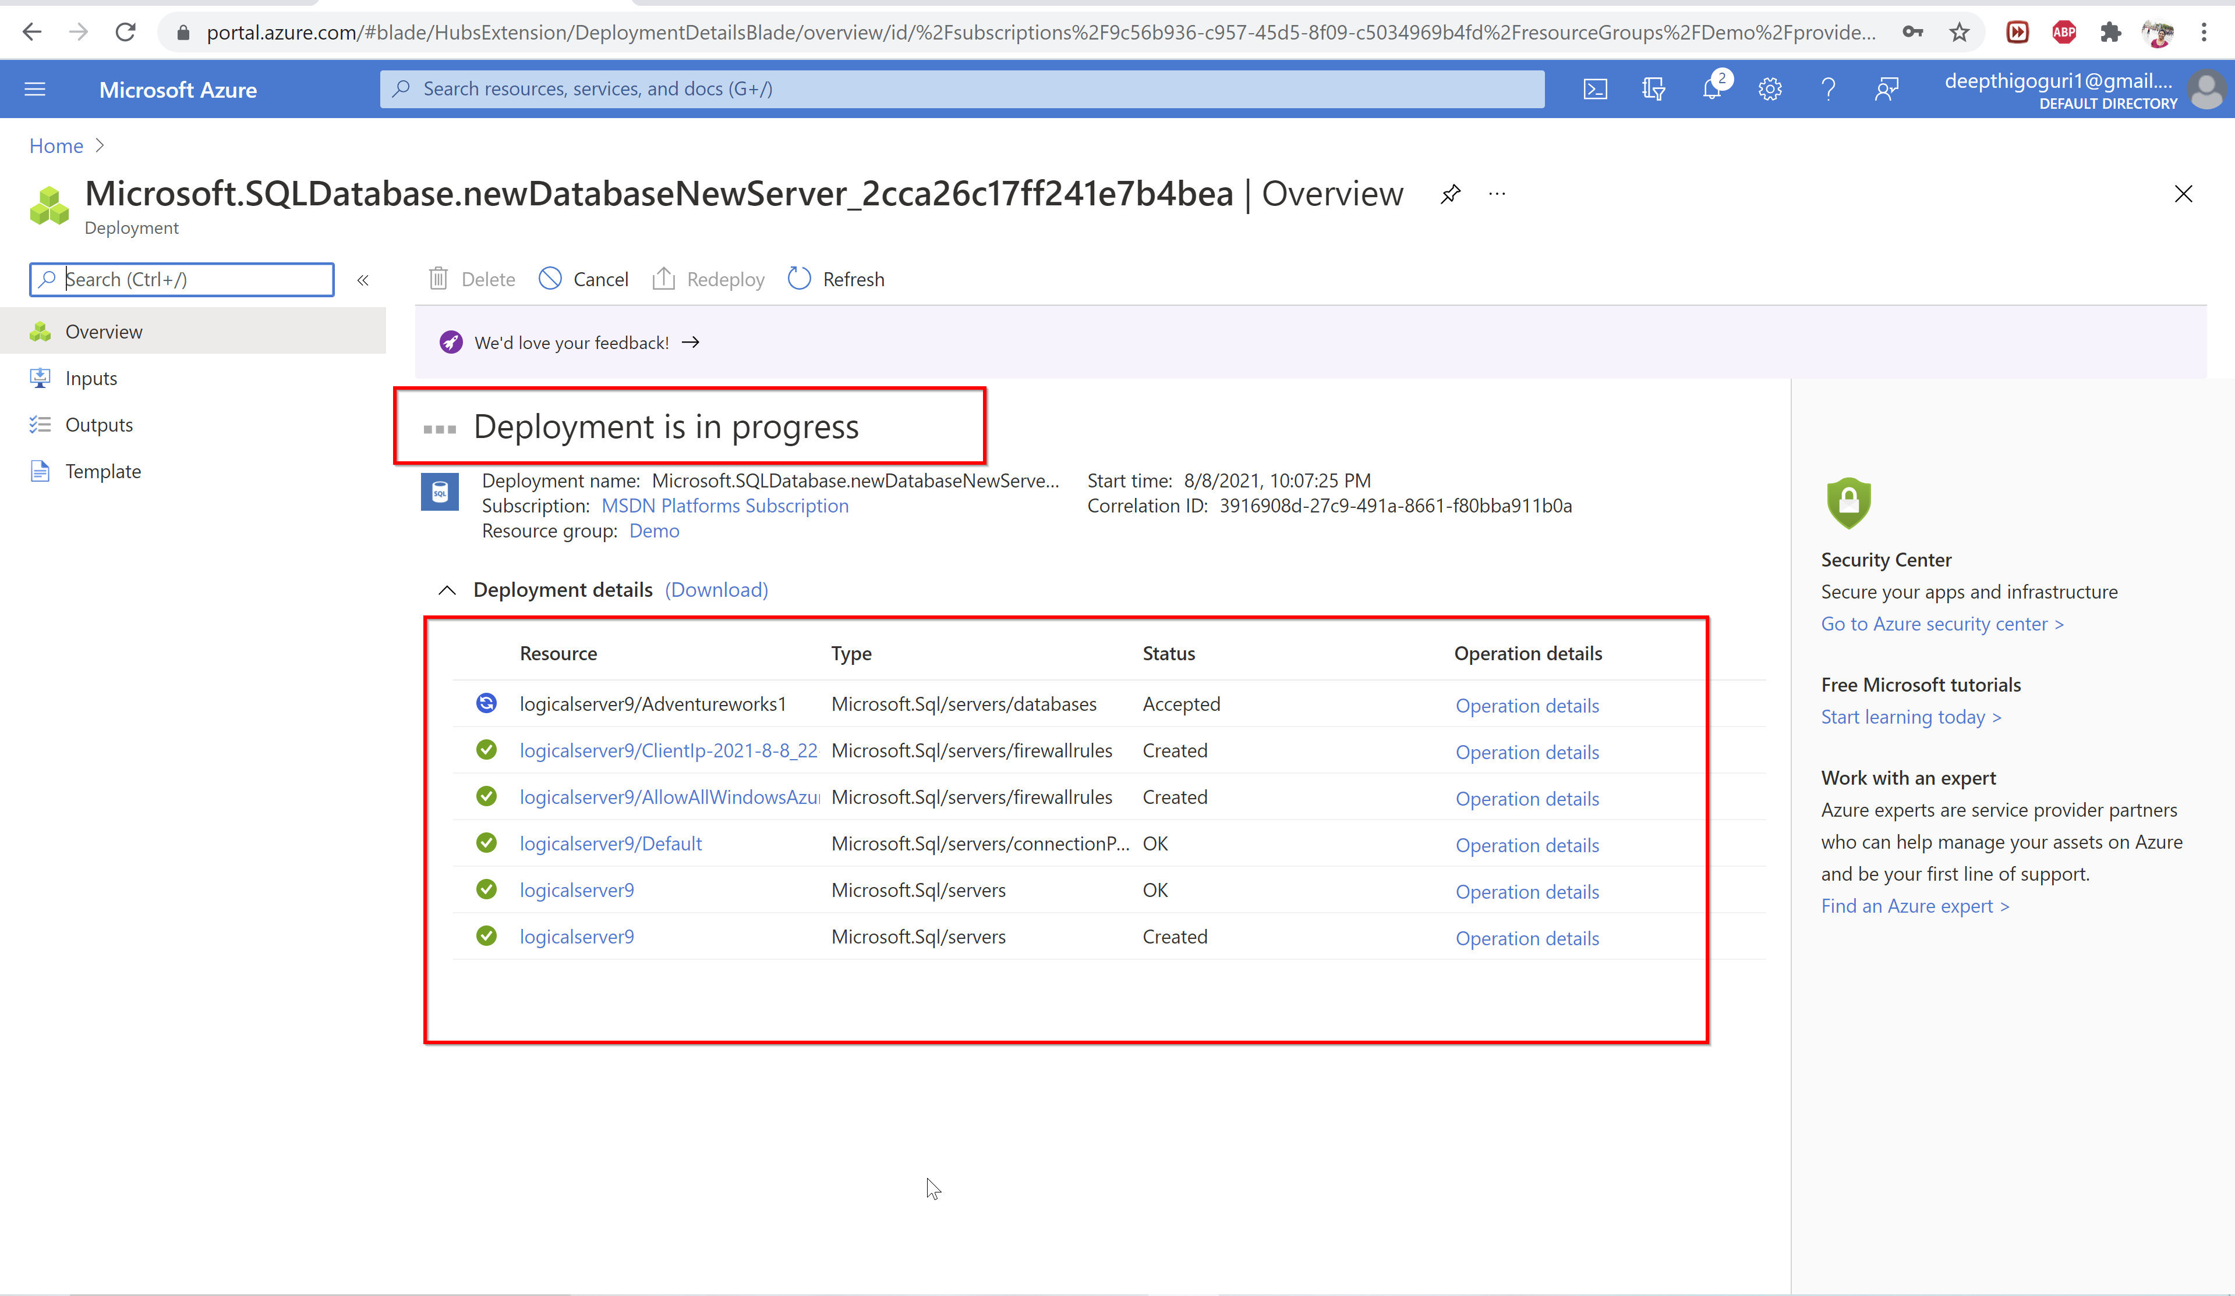

Slide 47
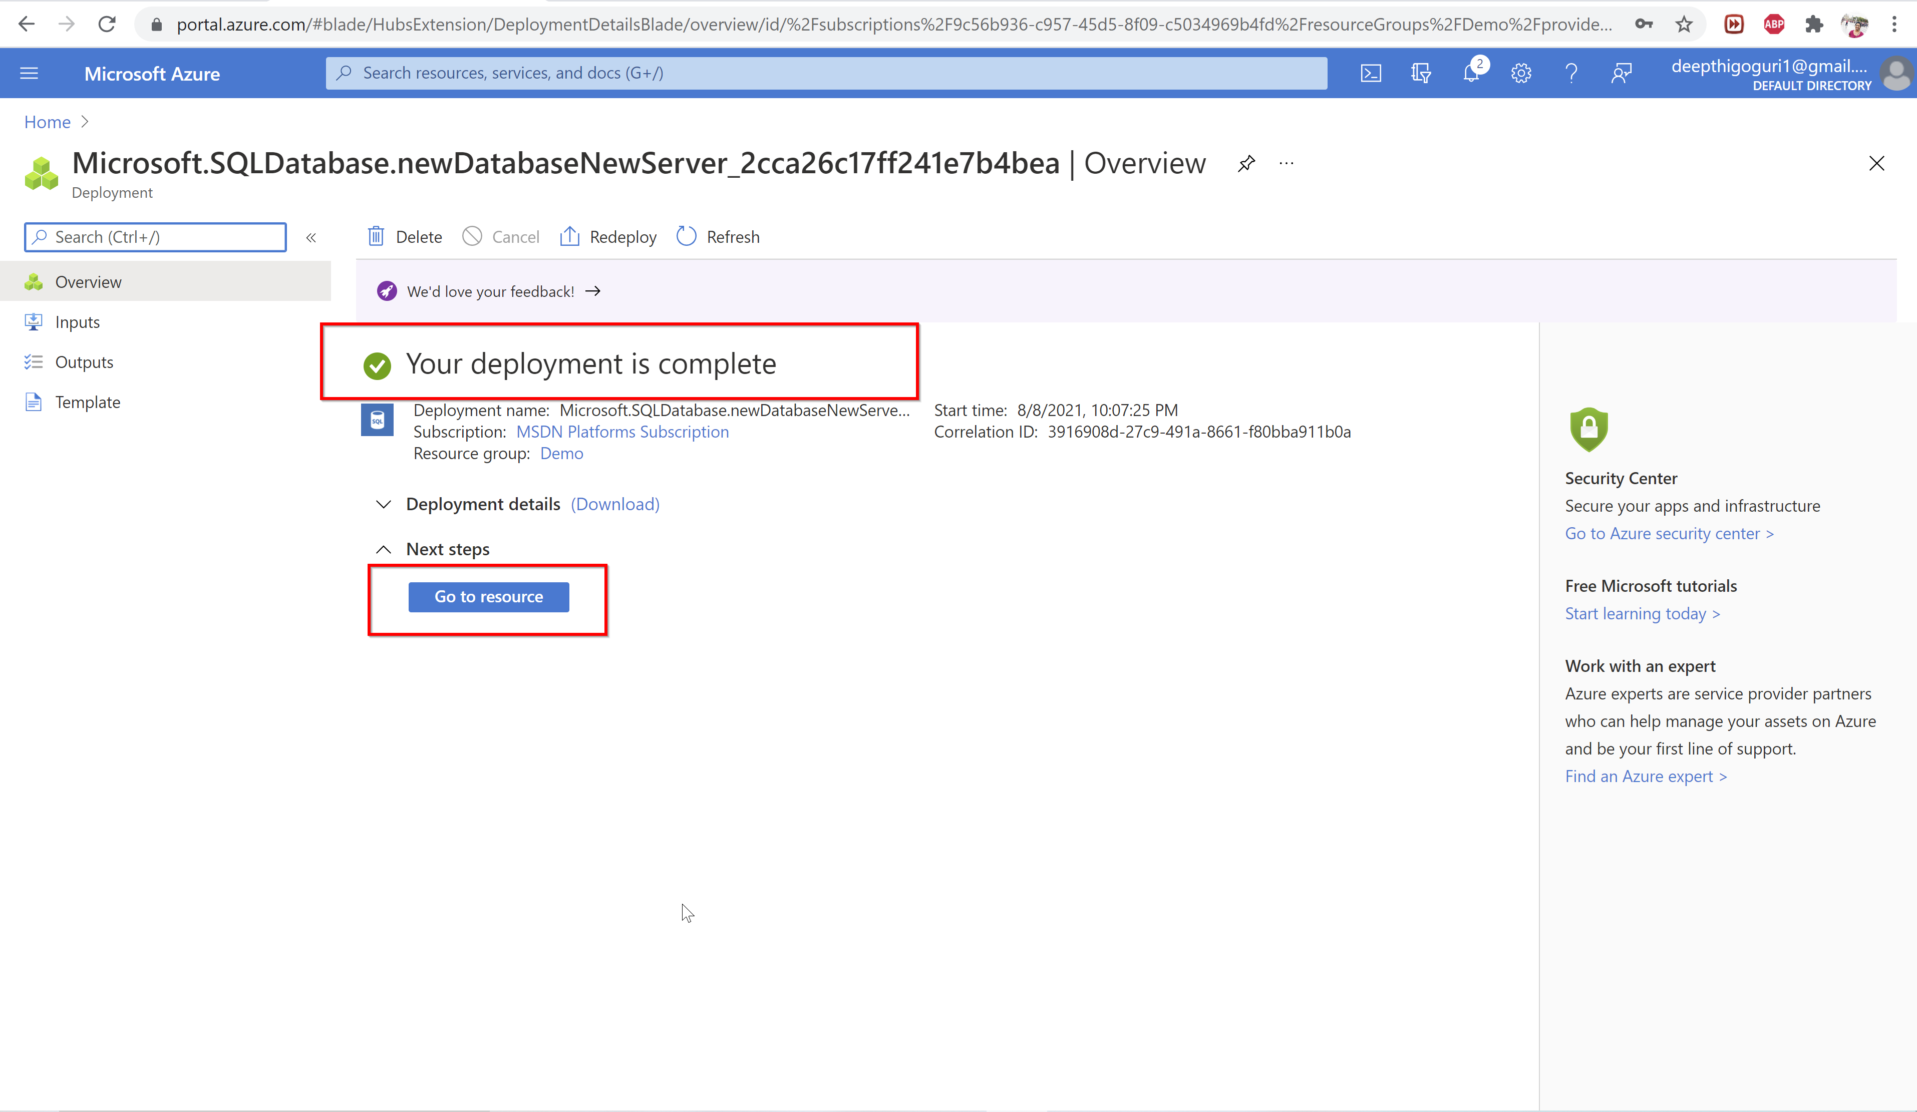

Slide 48
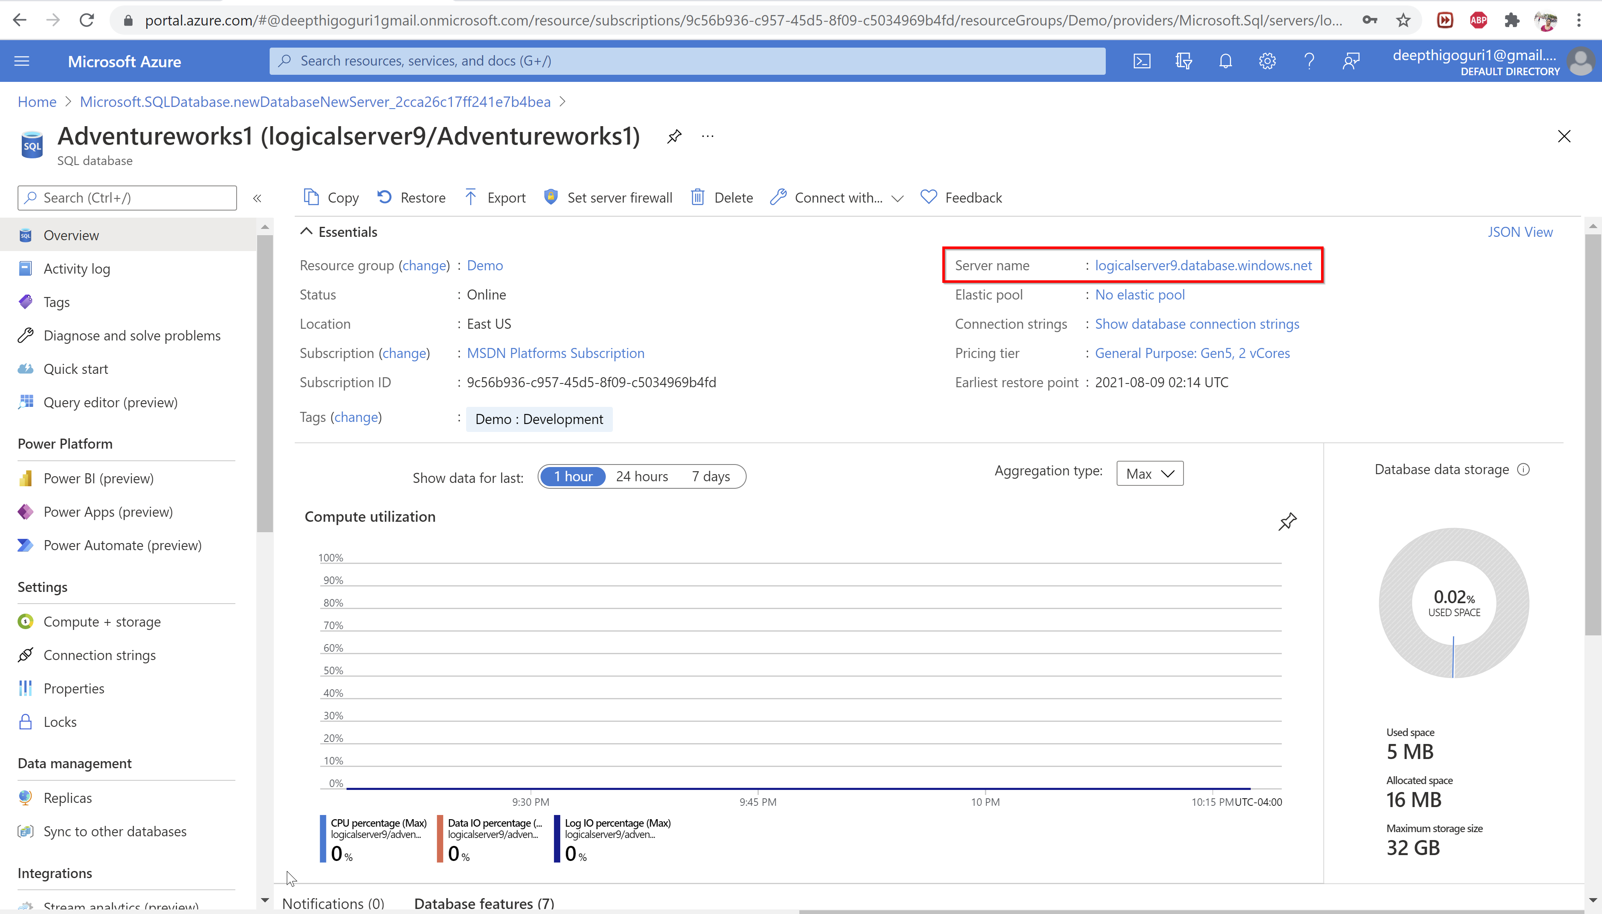

Slide 49
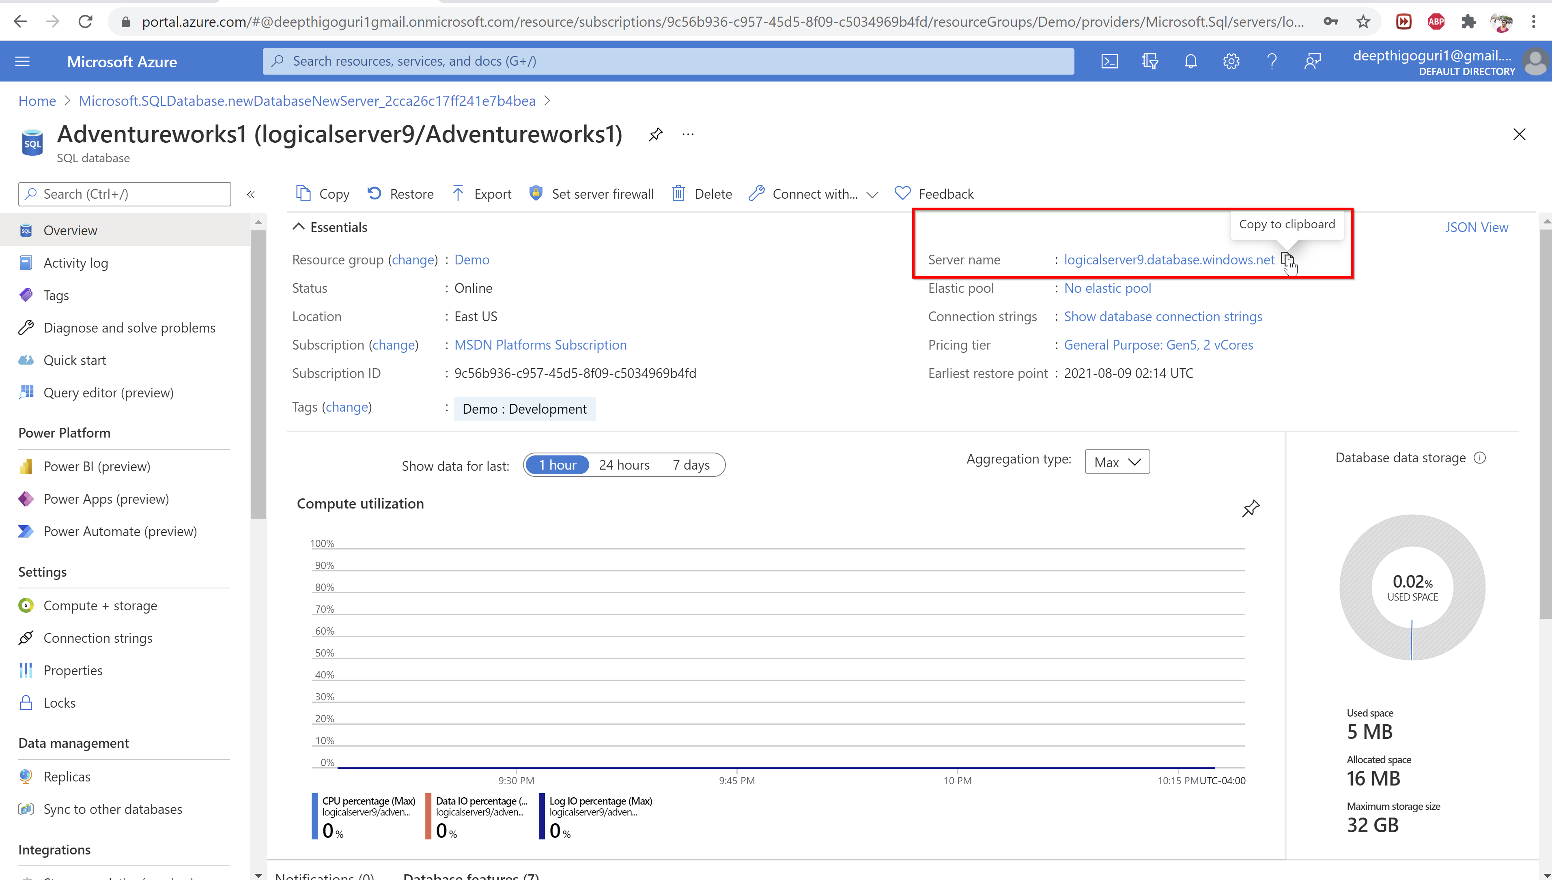

Slide 50
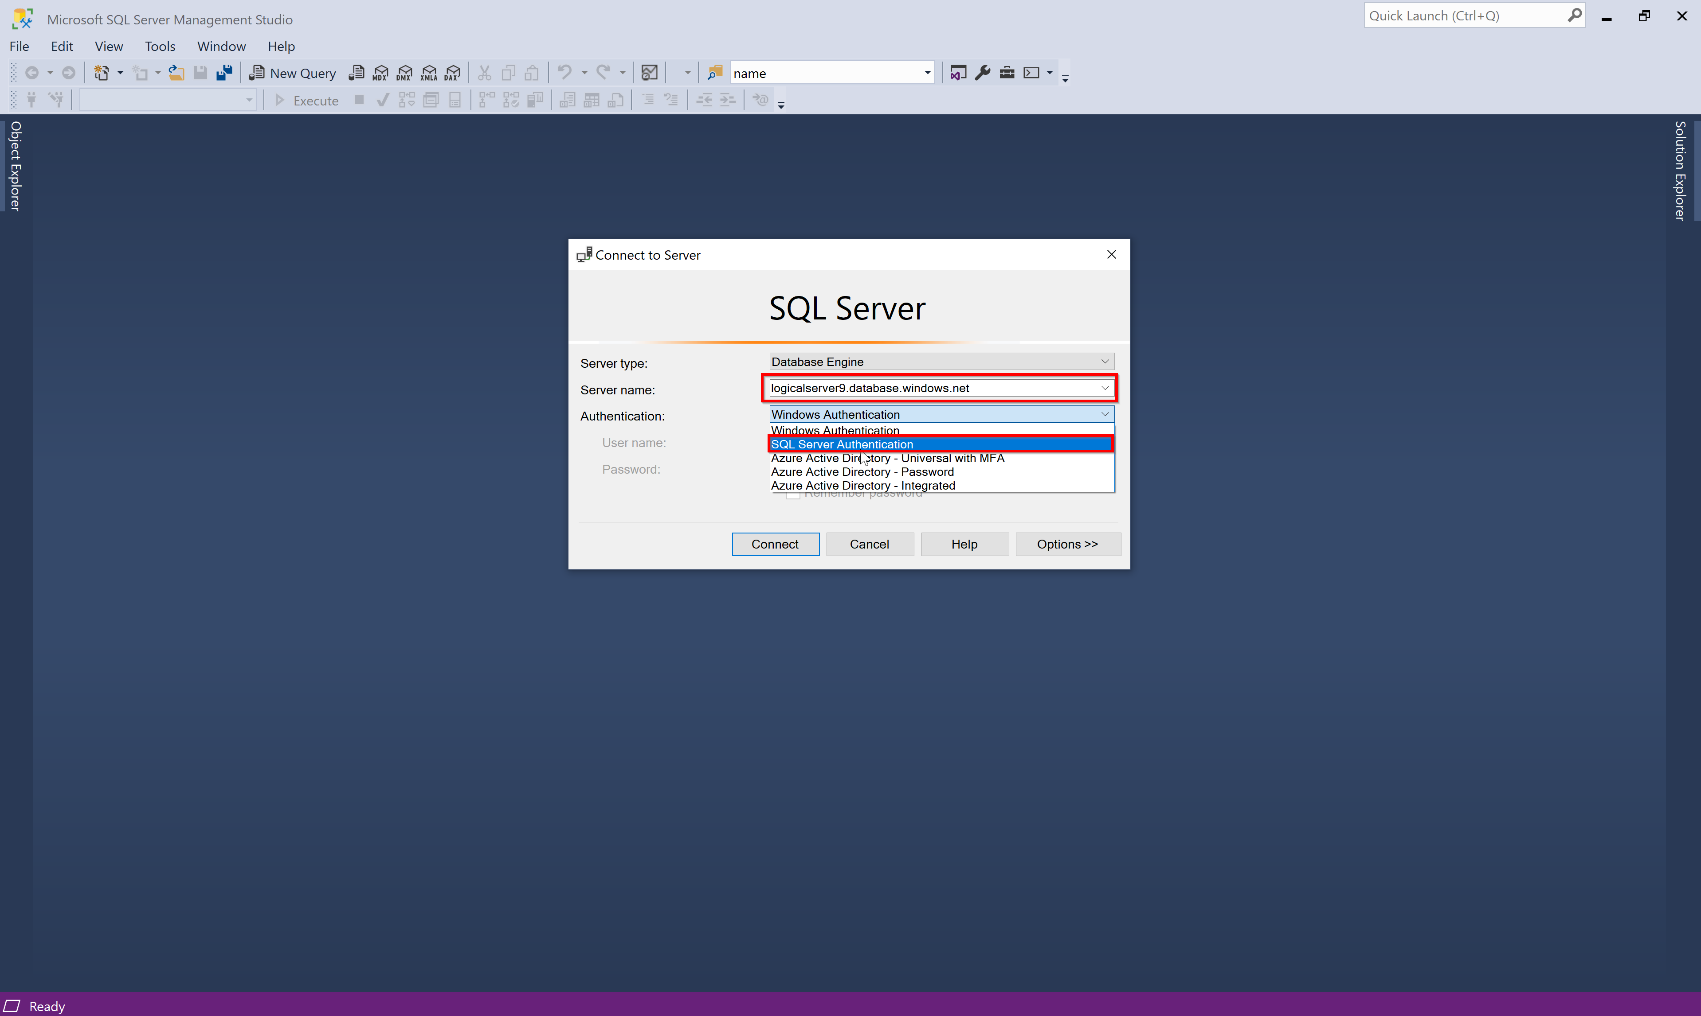

Slide 51
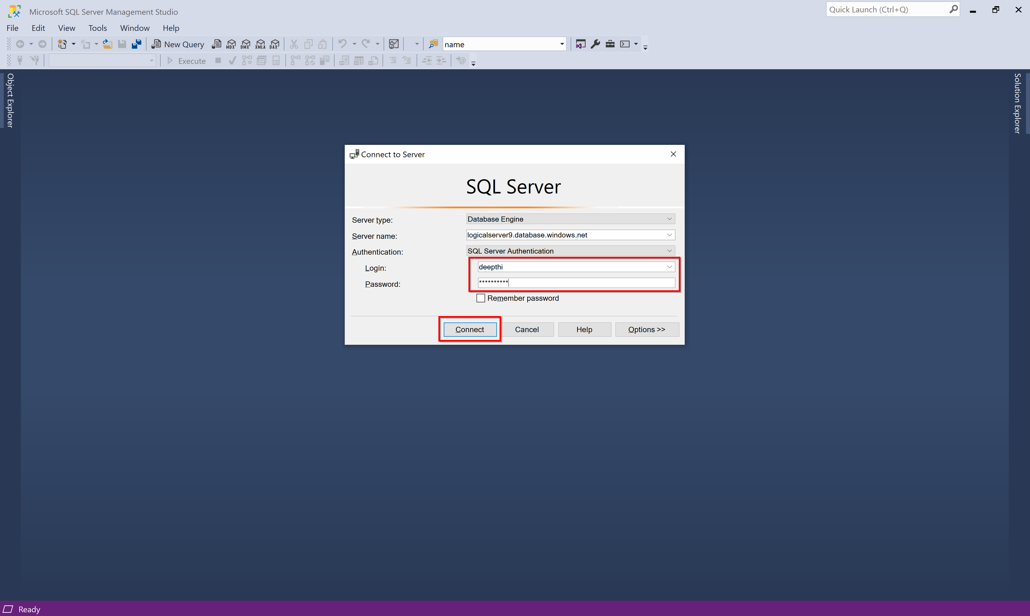

Slide 52
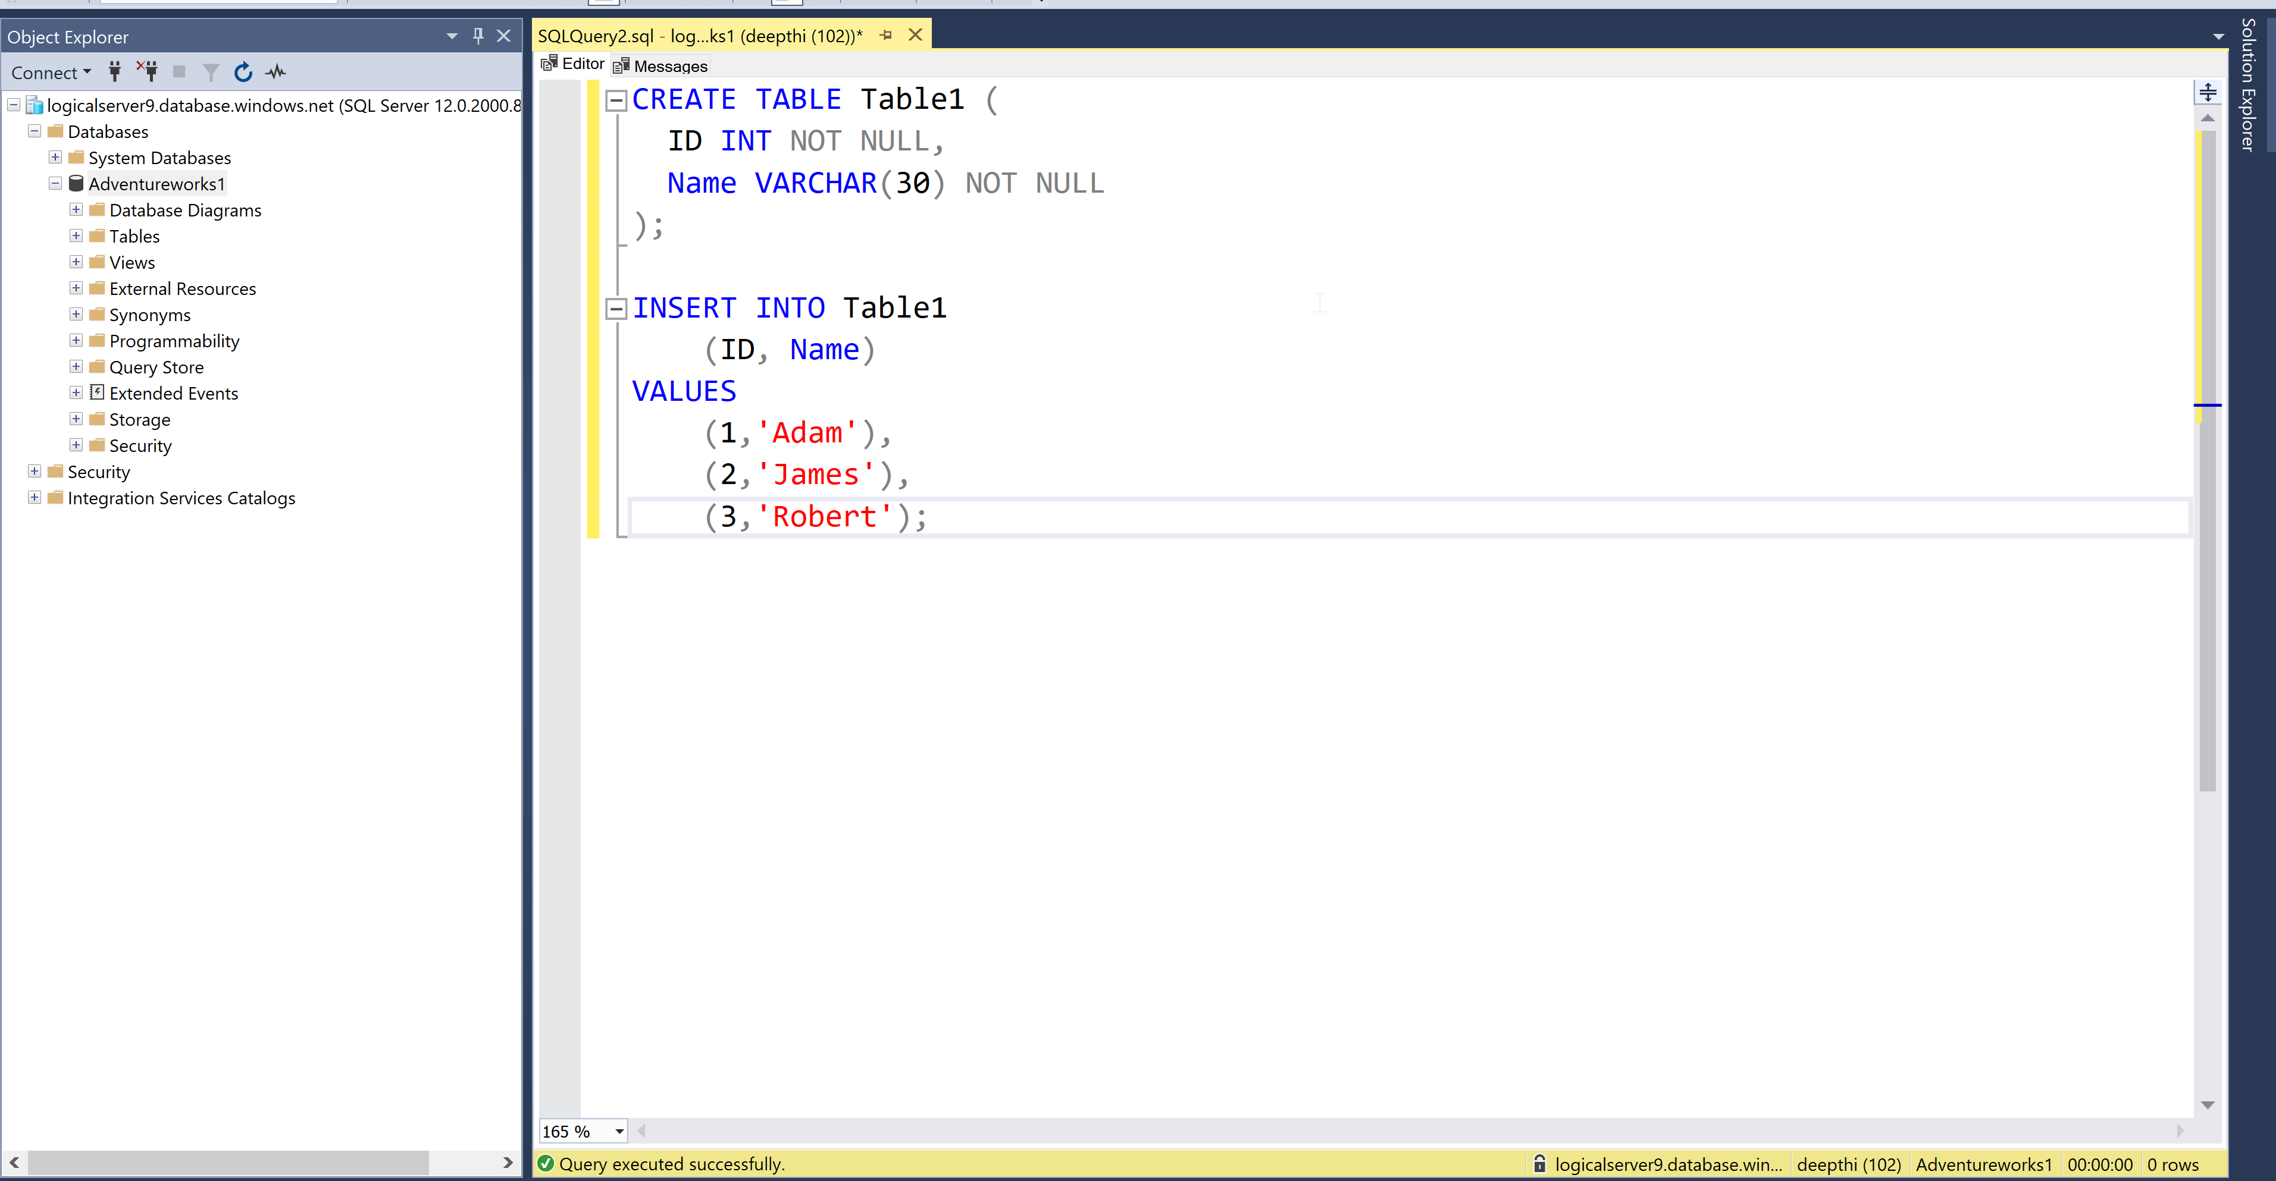

Slide 53
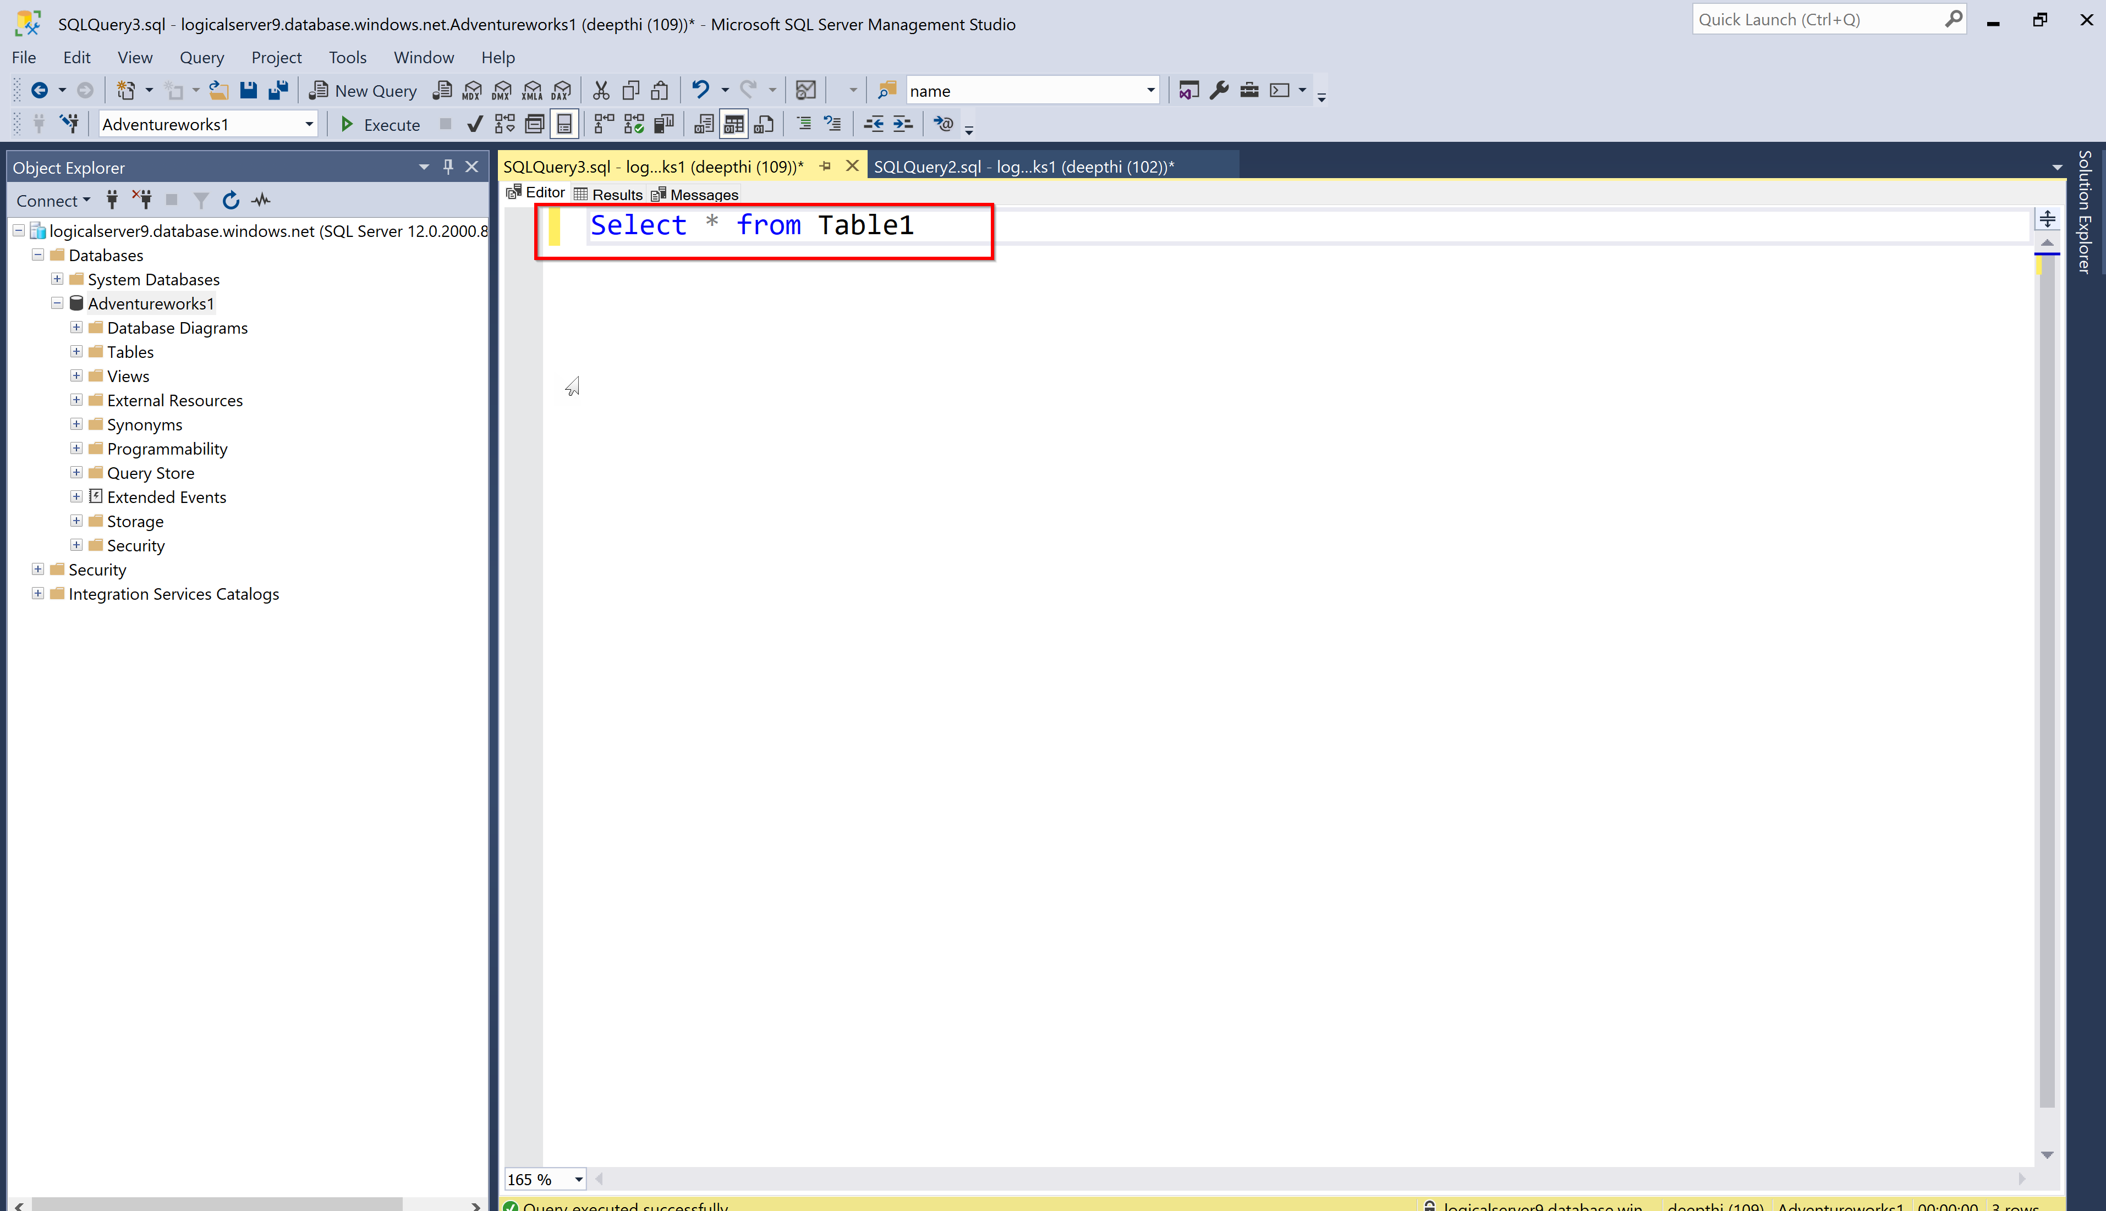

Slide 54
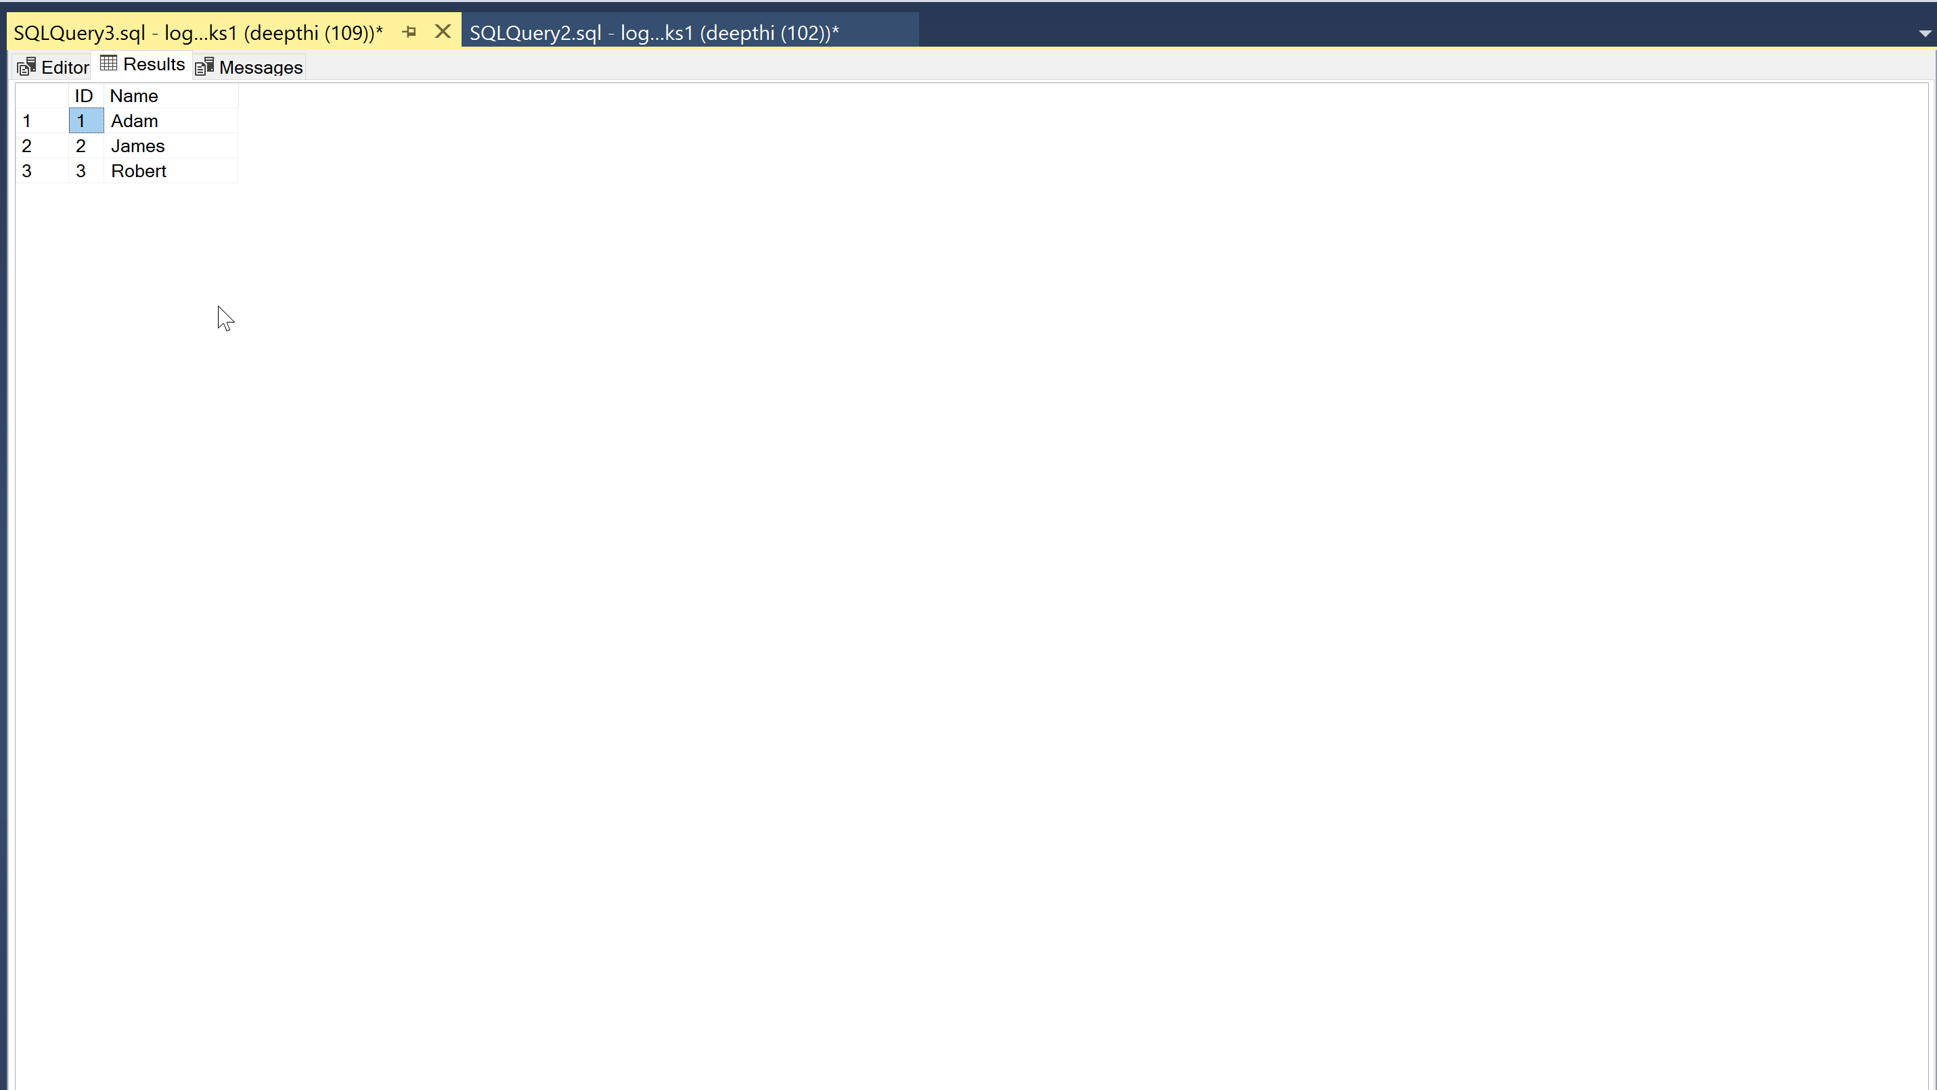

Slide 55





Our Partners

Slide 56
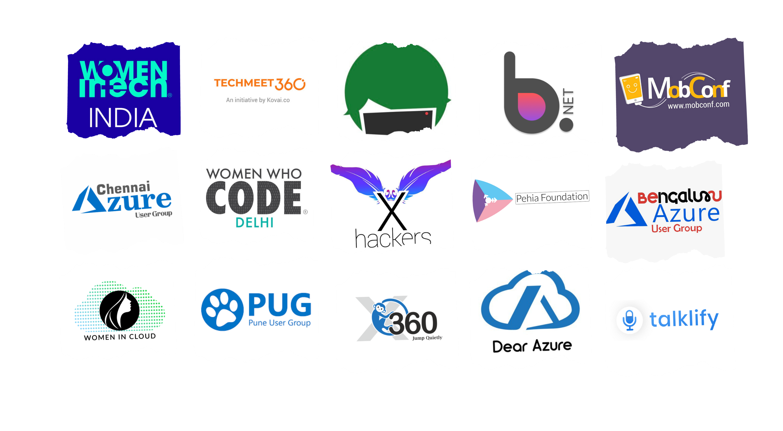
Communities

Slide 57
Q & A

Slide 58
Feedback

Slide 59
THANK YOU!
Deepthi Goguri

